Slide 1
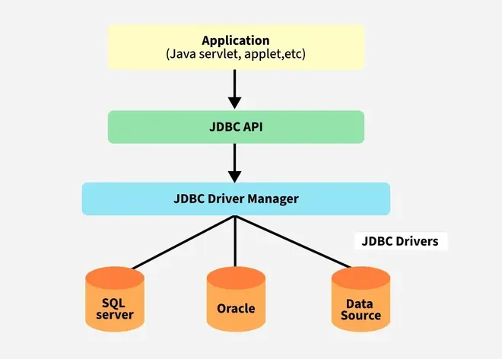
Overview of JDBC
JDBC (Java Database Connectivity) is an API for connecting and executing queries in databases.
Located in the package java.sql
Provides methods for querying and updating data in relational databases
JDBC Architecture:
1. Application Layer
2. JDBC Driver Manager
3. JDBC Drivers
4. Database

Slide 2
Native and ODBC Drivers
ODBC (Open Database Connectivity): Generic database access standard by Microsoft.
JDBC-ODBC Bridge (Type 1 Driver): Converts JDBC calls into ODBC calls.
Native Driver (Type 2 Driver): Platform-specific driver communicating directly with the database.

Slide 3
Types of JDBC Drivers
Type 1 – JDBC-ODBC Bridge: Converts JDBC calls into ODBC calls.
Type 2 – Native API Driver: Uses native libraries for database.
Type 3 – Network Protocol Driver: Translates JDBC calls into DB-independent protocol.
Type 4 – Thin Driver: Pure Java driver communicating directly via TCP/IP.
Preferred: Type 4 (Platform Independent).

Slide 4
Usage of Drivers
Steps to use JDBC drivers:
1. Load the driver class:
Class.forName("com.mysql.cj.jdbc.Driver");
2. Establish connection:
Connection con = DriverManager.getConnection(url, user, password);
3. Create Statement / PreparedStatement
4. Execute Query
5. Close Connection.

Slide 5
Properties-based Connection Factory
Use .properties file to store connection details:
db.url=jdbc:mysql://localhost:3306/studentdb
db.user=root
db.password=12345
Java Code:
Properties props = new Properties();
props.load(new FileInputStream("db.properties"));
Connection con = DriverManager.getConnection(
props.getProperty("db.url"),
props.getProperty("db.user"),
props.getProperty("db.password"));

Slide 6
Basic Database Operations
Operation | SQL Command | Java Method
------------|------------------|-----------------
Insert | INSERT INTO | executeUpdate()
Delete | DELETE FROM | executeUpdate()
Update | UPDATE SET | executeUpdate()
Select | SELECT FROM | executeQuery()

Slide 7
Example: Insert Record
Statement stmt = con.createStatement();
stmt.executeUpdate("INSERT INTO student VALUES(101,'Amit',90)");

Slide 8
PreparedStatement
Precompiled SQL statement for performance and security.
Prevents SQL Injection and supports dynamic parameters.
PreparedStatement ps = con.prepareStatement("INSERT INTO student VALUES(?, ?, ?)");
ps.setInt(1, 101);
ps.setString(2, "Amit");
ps.setInt(3, 90);
ps.executeUpdate();

Slide 9
Executing Queries and Reading Results
PreparedStatement ps = con.prepareStatement("SELECT * FROM student");
ResultSet rs = ps.executeQuery();
while(rs.next()){
System.out.println(rs.getInt(1) + " " + rs.getString(2));
}

Slide 10
Summary
JDBC provides universal access to databases.
Type 4 driver is most efficient.
Use PreparedStatement for dynamic, secure SQL execution.
Always close Connection, Statement, and ResultSet.

