Slide 1
Security Promises of the JVM
The Java Virtual Machine (JVM) was designed with “write once, run anywhere” and safety first in mind. Unlike C/C++ where unchecked memory access can cause buffer overflows, JVM enforces strict rules to prevent malicious or buggy code from harming the system.
The JVM promises security in three main ways:
  Memory Safety
  Bytecode Verification
  Runtime Security Checks

Slide 2
Memory Safety
No direct pointer access (unlike C/C++) → prevents buffer overflows and memory corruption.
Automatic garbage collection ensures memory is freed safely.

Slide 3
Bytecode Verification
Before execution, the JVM verifies the .class files.
Checks include:
  No illegal data conversions.
  Stack underflow/overflow prevention.
  Method calls match correct signatures.
  Access to private/protected data is not violated.

Slide 4
Runtime Security Checks
Array bounds checking (you cannot access arr[10] if array length is 5
Type safety (no casting a String into an Integer wrongly).
Prevents illegal memory or system resource access.
  public class Test {
  public static void main(String[] args) {
  int[] arr = new int[5];
  arr[10] = 50; // JVM throws ArrayIndexOutOfBoundsException
  }
  }

Slide 5
Security Architecture and Security Policy
Java has a pluggable security architecture. It allows applications to run in a controlled environment, often called the Java Sandbox.
Class Loader
Bytecode Verifier
Security Manager
Access Controller & Policy Files
Java Cryptography Architecture (JCA)

Slide 6
Class Loader
Loads Java classes into the JVM.
Ensures code from different sources (local disk, network, jar file) doesn’t interfere.
Prevents malicious classes from replacing core Java API classes.

Slide 7
Bytecode Verifier
Ensures bytecode follows Java’s security rules before execution.
Before execution, the JVM verifies the .class files.
Protects from tampered .class files.

Slide 8
Security Manager
Enforces runtime permissions.
For example, an applet downloaded from the internet:
Cannot read/write local files.
Cannot open arbitrary network connections.
Permissions can be customized.
public class MySecurityManager extends SecurityManager {
public void checkRead(String file) {
throw new SecurityException("File read not allowed!");
}
}

Slide 9
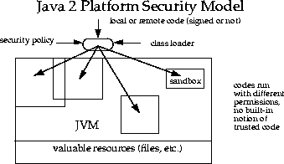
Access Controller & Policy Files
Java uses policy files (.policy) to define who can do what.

Slide 10
Java Cryptography Architecture (JCA)
Provides APIs for encryption, message digests, digital signatures, etc.
Examples:
  MessageDigest →(e.g., SHA-256)
  Cipher→(AES, RSA)
  KeyStore →managing certificates

Slide 11
Security Aspects in Java
Beyond JVM-level checks, Java has multiple layers of security features:
Sandbox Model
  Originated in applets (untrusted code from browsers).
  Restricts file access, system properties, networking, etc.
  Still used in modern Java Web Start and enterprise systems.
Permissions and Policies
  Fine-grained access control through
  Example: Allow only network communication, but deny file access.

Slide 12
Authentication & Authorization
  JAAS (Java Authentication and Authorization Service)
  Provides pluggable login modules (LDAP, Kerberos, Database).
  Separates authentication (who you are) from authorization (what you can do)
Cryptographic Security
  javax.crypto→AES, DES, RSA encryption
  java.security→SecureRandom, KeyFactory, MessageDigest.
  Example (SHA-256 hashing):

Slide 13
Cont..
Code Signing
  java supports signed JAR files.
  Signed JAR proves the authenticity of the publisher.
  Unsigned JARs → restricted permissions.
Secure Communication
  Java Secure Socket Extension (JSSE) provides SSL/TLS support.
  HTTPS, secure sockets, certificates.

Slide 14
Sandbox Security Model
In computer security, a sandbox is a security mechanism for separating running programs, usually in order to minimize system failures or software vulnerabilities from spreading.
In general, a sandbox is an isolated computing environment in which a program or file can be executed without affecting the application in which it runs.
Sandboxes are used by software developers to test new programming code.
A sandbox typically provides a tightly controlled set of resources for guest programs to run in, such as limited space on disk and memory.
In a Java programming language, the sandbox is the program area and it has some set of rules that programmers need to follow when creating Java code (like an applet) that is sent as part of a page.

Slide 15
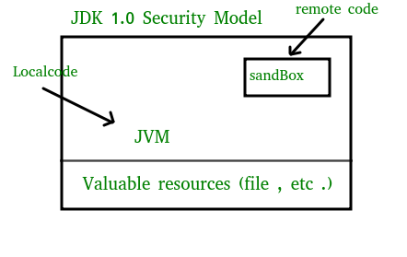
sandbox model
The original security model provided by the Java platform is known as the sandbox model, which existed in order to provide a very restricted environment in which to run untrusted code obtained from the open network.
The essence of the sandbox model is that local code is trusted to have full access to vital system resources (such as the file system) while downloaded remote code (an applet) is not trusted and can access only the limited resources provided inside the sandbox.

Slide 16
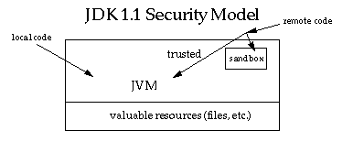
The sandbox model was deployed through the Java Development Kit (JDK), and was generally adopted by applications built with JDK 1.0, including Java-enabled web browsers.
The language is designed to be type-safe and easy to use , i.e, the hope is that the burden on the programmer is such that the likelihood of making mistakes is less compared to using other programming languages such as C or C++.
Language features such as automatic memory management, garbage collection, and range checking on strings and arrays are examples of how the language helps the programmer to write safe code.
Second, compilers and a bytecode verifier ensure that only legitimate Java bytecodes are executed. The bytecode verifier, together with the Java Virtual Machine, guarantees language safety at run time.
A ClassLoader defines a local name space, which can be used to ensure that an untrusted applet cannot interfere with the running of other programs.
Finally, access to crucial system resources is mediated by the Java Virtual Machine and is checked in advance by a SecurityManager class that restricts the actions of a piece of untrusted code to the bare minimum.(SandBoxing)

Slide 17
Usage
Sandboxing is frequently used to test unverified programs that may contain a virus or other malicious code, without allowing the software to harm the host device. Implementations Online judge systems to test programs in programming contests.
New-generation pastebins allowing users to execute pasted code snippets on the pastebin's server.
HTML5 has a "sandbox" attribute for use with iframes.
Secure Computing Mode(seccomp) is a sandbox built in the Linux kernel. When activated, seccomp only allows the write(), read(), exit(), and sigreturn() system calls.

Slide 18
Sandbox − Advantages and Disadvantages
When it comes to new software, it comprises a controllable test environment.
It safeguards the hardware, operating system, and database of registrations.
The host system will not have any unauthorized data access.
There will be no conflict between the operating system and the programs because of sandboxing.
It also protects the system from malware, which secures the web browser.
The only drawback is that complex sandbox tools are expensive and time-consuming to use.

