Slide 1
Relation b/w JVM, JRE and JDK
Prof Savita Sheoran

Slide 2
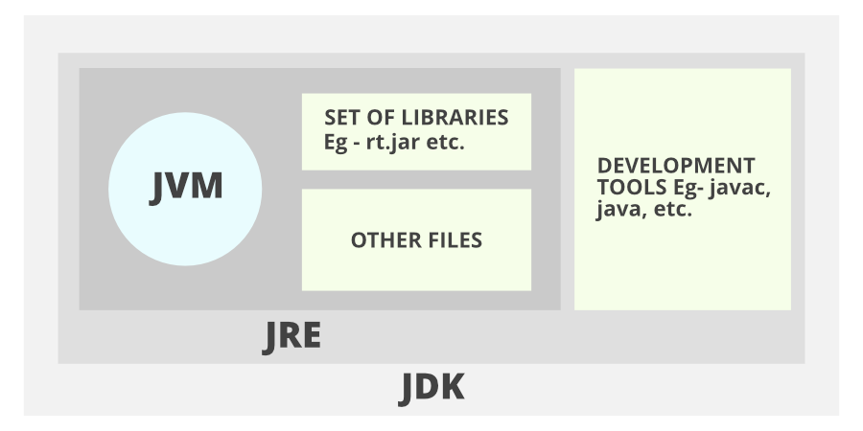
Introduction

Slide 3
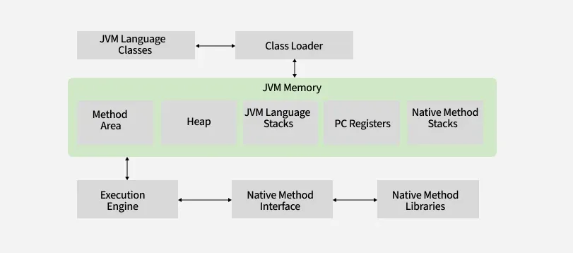
JVM (Java Virtual Machine)
Definition: JVM is the engine that runs Java bytecode.
Role: It takes the compiled .class files (bytecode) and converts them into machine code for the underlying operating system and hardware.
Key Point: JVM is platform-dependent (different implementations for Windows, Linux, Mac), but the bytecode it runs is platform-independent.

Slide 4
JRE (Java Runtime Environment)
Definition: JRE is a package that provides everything needed to run a Java program.
Contains:
  JVM
  Core libraries (like java.lang, java.io, java.util)
  Other runtime components
Role: Allows you to execute Java applications, but does not provide tools to develop them.

Slide 5
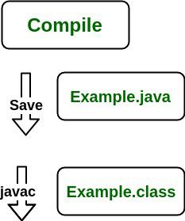
JDK (Java Development Kit)
Definition: JDK is a full package required to develop Java applications.
Contains:
  JRE (which itself contains JVM + libraries)
  Development tools like javac, Javadoc, jdb, tect
Role: Used by developers to write, compile, and debug Java programs.

Slide 6
Relation in Simple Terms &Analogy
  JVM → Runs Java bytecode
  JRE = JVM + Libraries (to run Java programs)
  JDK = JRE + Development tools (to write and run Java programs)
Analogy
  JVM → Like an engine.
  JRE → Engine + fuel + basic parts so the car can run.
  JDK → Full car factory (car + tools to build/repair new cars).

Slide 7
Comparision
Feature | JVM (Java Virtual Machine) | JRE (Java Runtime Environment) | JDK (Java Development Kit)
Definition | Abstract machine that runs Java bytecode | Package providing environment to run Java programs | Full package for developing and running Java programs
Contains | Execution engine, garbage collector, class loader | JVM + core libraries + supporting files | JRE + compilers (javac), tools (javadoc, jdb, etc.)
Purpose | Runs the compiled Java code (bytecode) means Executes Java bytecode | Provides runtime environment to execute Java apps means Used to run Java applications | Provides tools to develop, compile, debug, and run Java apps means Used to develop Java applications
User | End-user indirectly uses it | End-user who only needs to run Java apps | Developers who write and test Java apps
Can it run Java programs? | Yes, but needs libraries (comes from JRE) | Yes | Yes
Can it compile Java code? | ❌ No | ❌ No | ✅ Yes (javac compiler)
Platform dependency | Implementation is platform-dependent | Platform-dependent (because JVM inside varies) | Platform-dependent (includes JRE + JVM)

Slide 8
What is a JAR file?
JAR stands for Java ARchive.
  It is a file format based on ZIP compression, used to bundle multiple Java-related resources into a single file.
  A JAR file can contain:
    Compiled Java classes (.class files)
    Metadata (like MANIFEST.MF)
    Configuration files
    Images, audio, and other resources
  A JAR file = ZIP file + Java-specific metadata. It simplifies packaging, deployment, and distribution of Java applications and libraries.

Slide 9
Why JAR is used?
Packaging – Instead of distributing many .class files, all files can be bundled in one archive.
Portability – Works across platforms (Java is platform-independent).
Execution – A JAR can be made executable (with Main-class specified in MANIFEST.MF/META-INF so it runs like a program (java -jar MyApp.jar)
Library distribution – Java libraries/frameworks are commonly distributed as JAR files.

Slide 10
Structure of a JAR File
MyApp.jar
├── META-INF/
│ └── MANIFEST.MF (metadata: version, main class, etc.)
├── com/
│ └── example/
│ └── MyClass.class
├── resources/
│ └── logo.png
└── config.properties

Slide 11
Working with JAR Files
Creating JAR:
  jar cf MyApp.jar MyClass.class
Viewing Contents:
  jar tf MyApp.jar
Running Executable JAR:
  java -jar MyApp.jar
Extracting a JAR file
  jar xf jarfilename

