Slide 1
MUCOSAL DRUG DELIVERY
B.PHARM VII SEMESTER
NOVEL DRUG DELIVERY SYSTEM(BP701T)
UNIT-II
Dr. hemant yadav

Slide 2
LEARNING OBJECTIVES
To understand about the basic concept mucosal drug delivery system
Advantages & disadvantages of mucosal drug delivery system
Theories of muco-adhesion
Formulations of Mucoadhesive systems

Slide 3
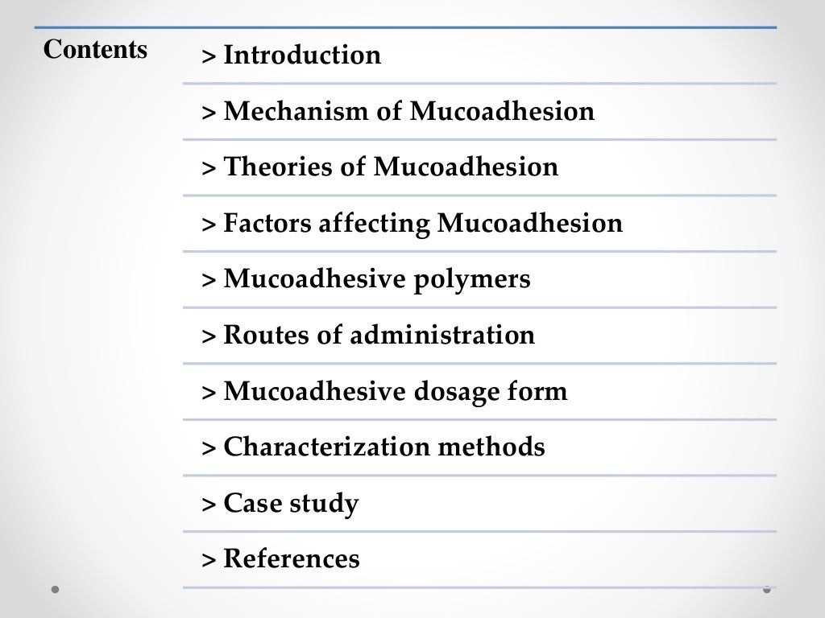

Slide 4
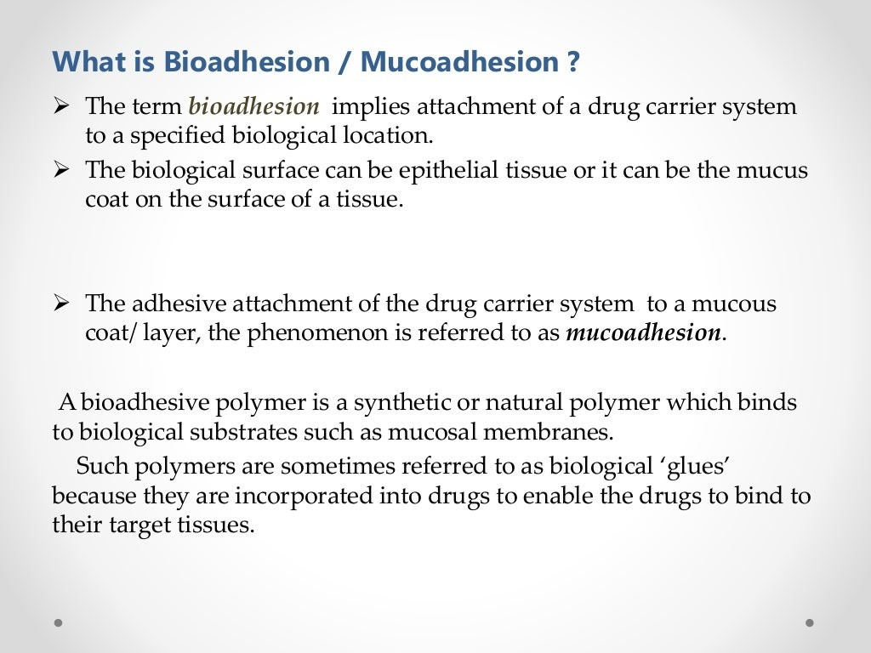

Slide 5
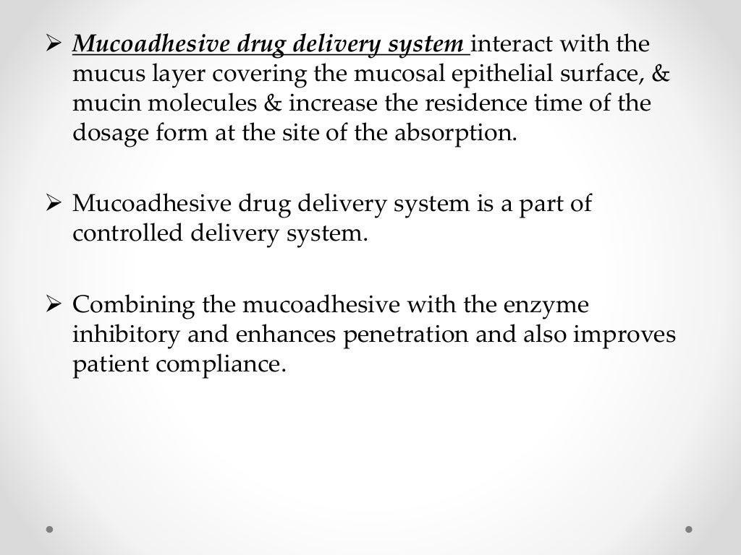

Slide 6
Advantages
Targeting and localization of drug
High drug flux
Painless administration
Low enzyme activity
Avoids first pass metabolism
Prolongation of residence time
Disadvantages
If adhere too tightly while removing damage to mucosa
Few patients unpleasant feeling
Ulcer causing drugs , as residence time is more
Lack of standardized techniques , unclear results

Slide 7
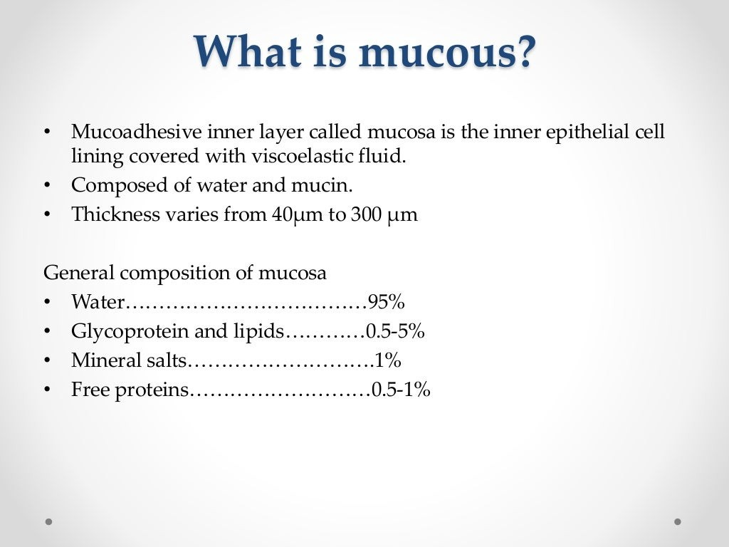

Slide 8
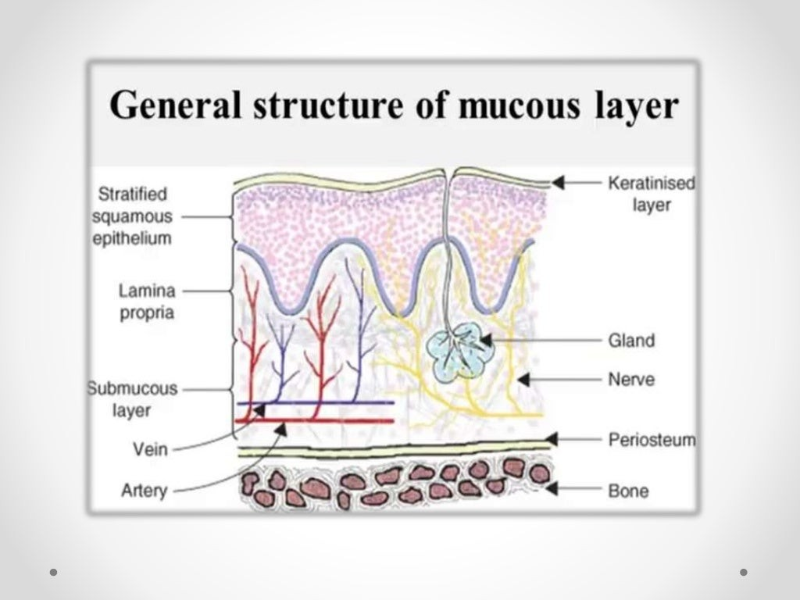

Slide 9
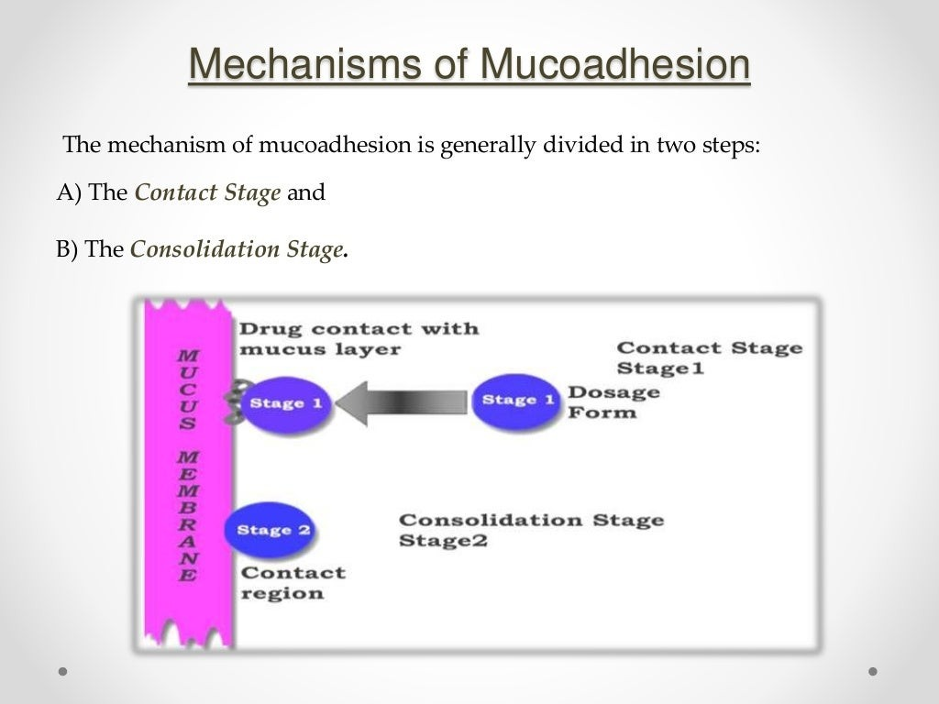

Slide 10
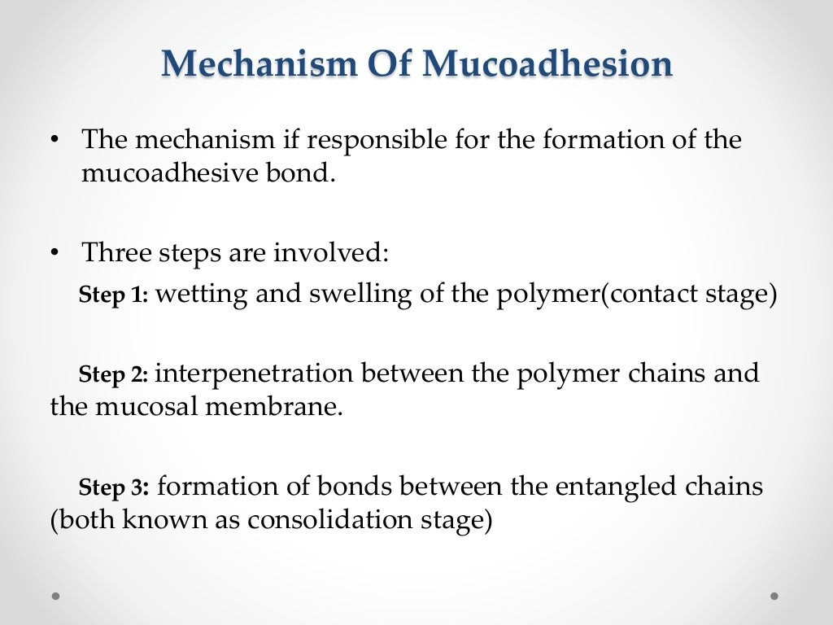

Slide 11
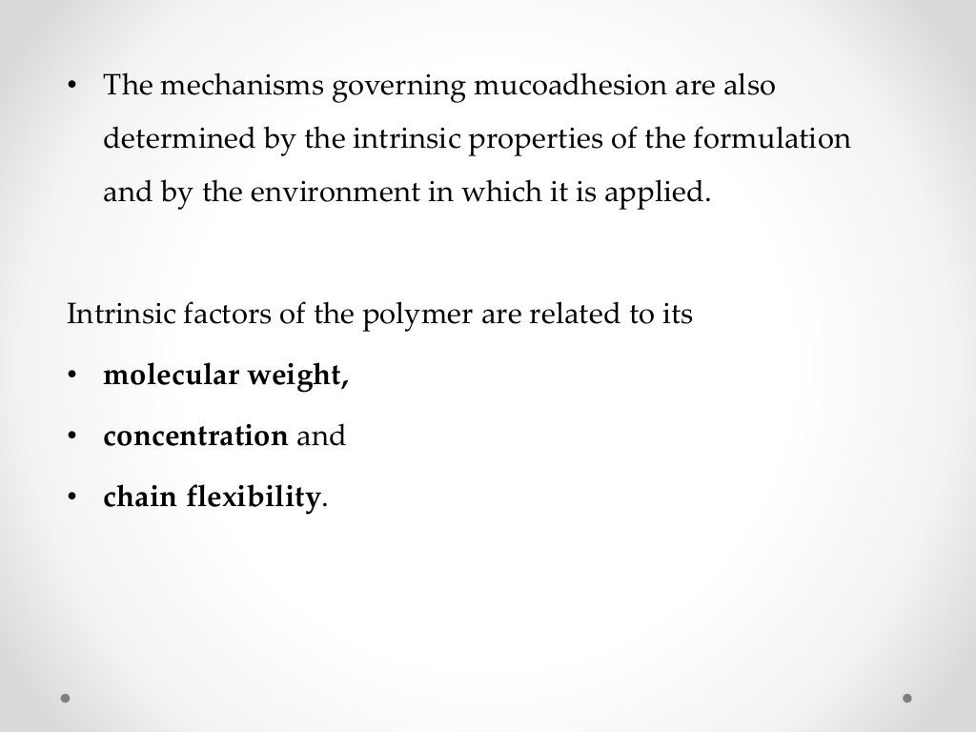

Slide 12
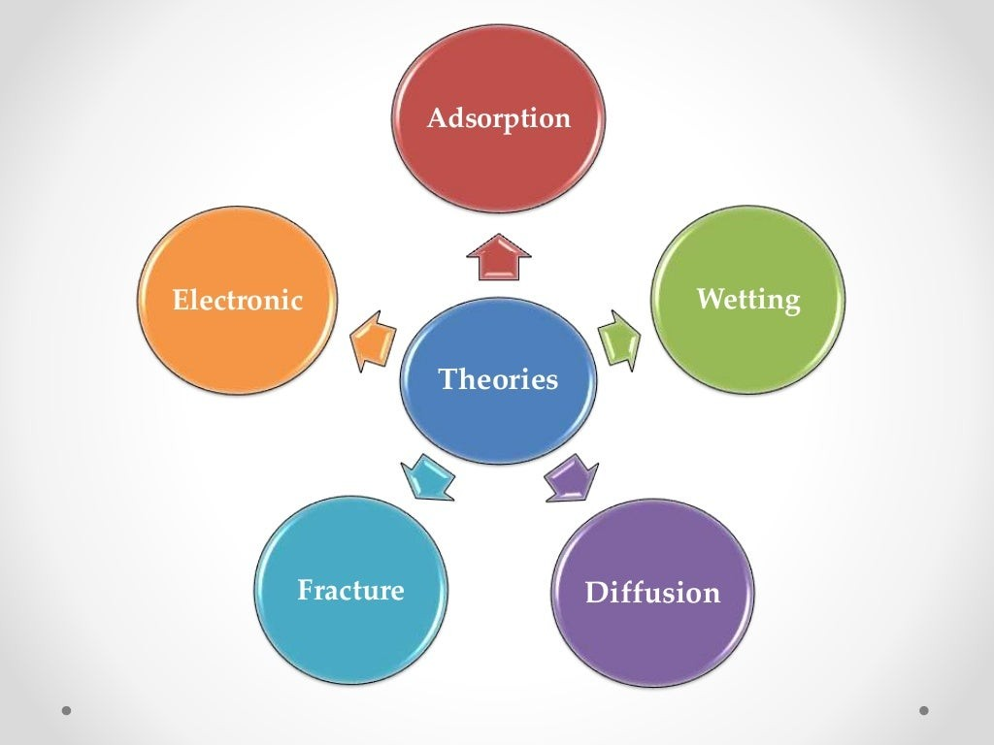

Slide 13
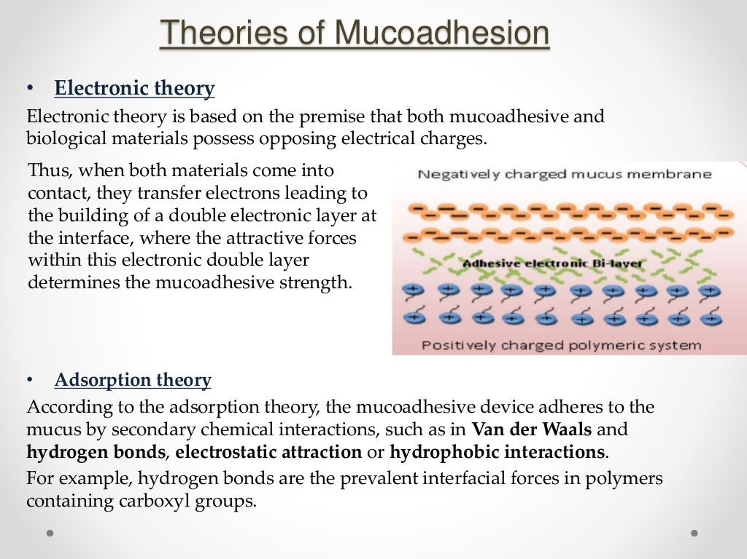

Slide 14
Diffusion interlocking theory
Interpenetration of both polymer and mucin chains to sufficient depth to create a semi permanent adhesive bond.
Adhesion force increases with increase in degree of penetration of polymer chains.

Slide 15
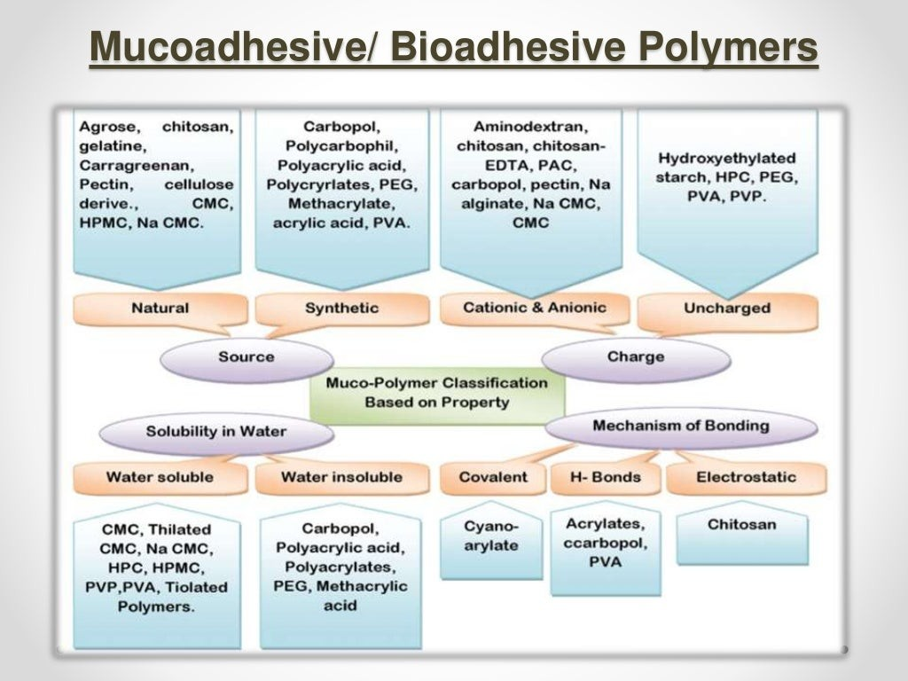

Slide 16
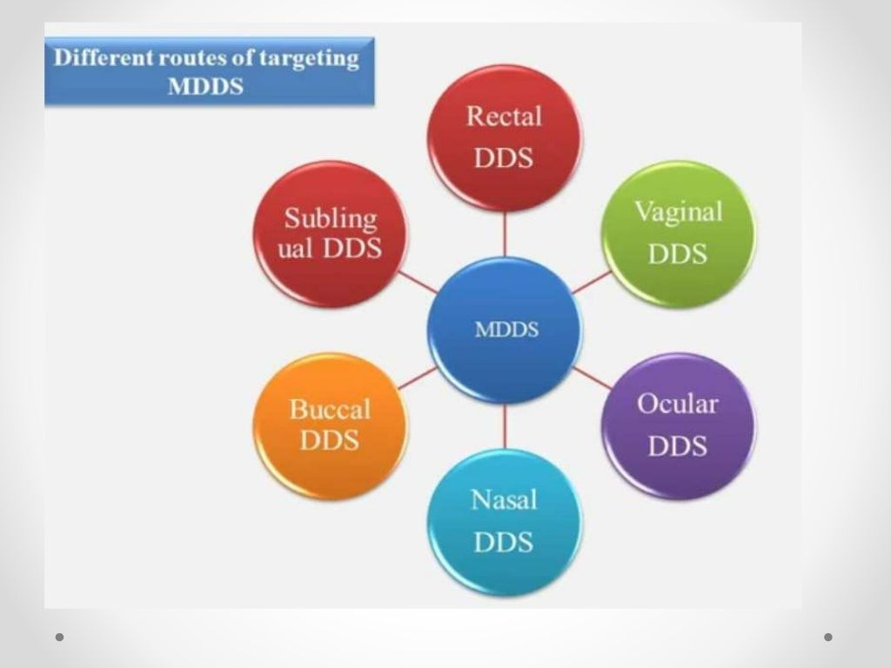

Slide 17
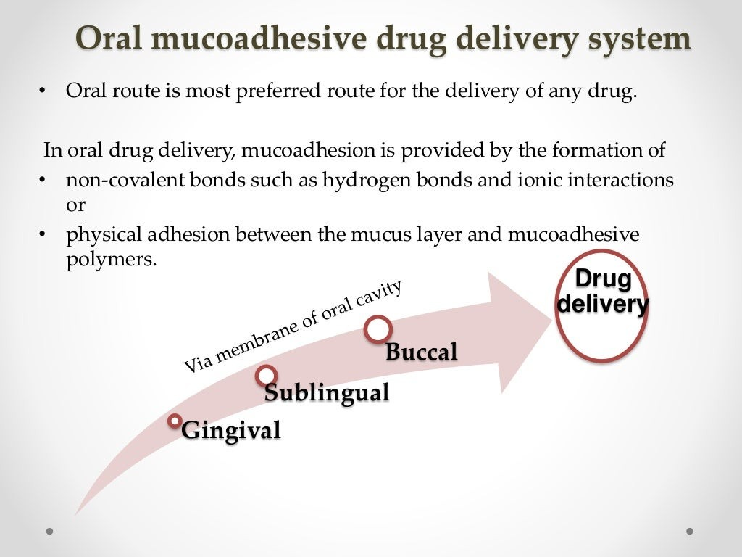

Slide 18
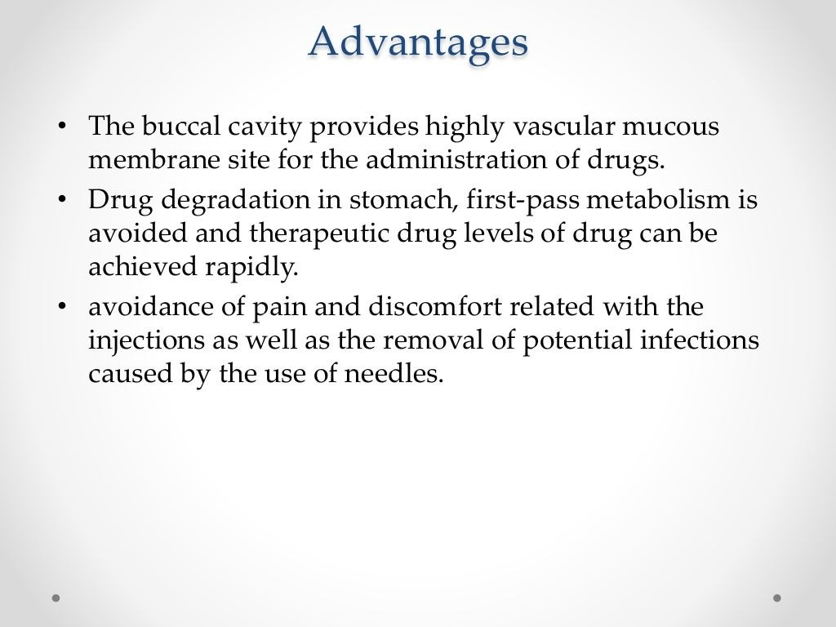

Slide 19
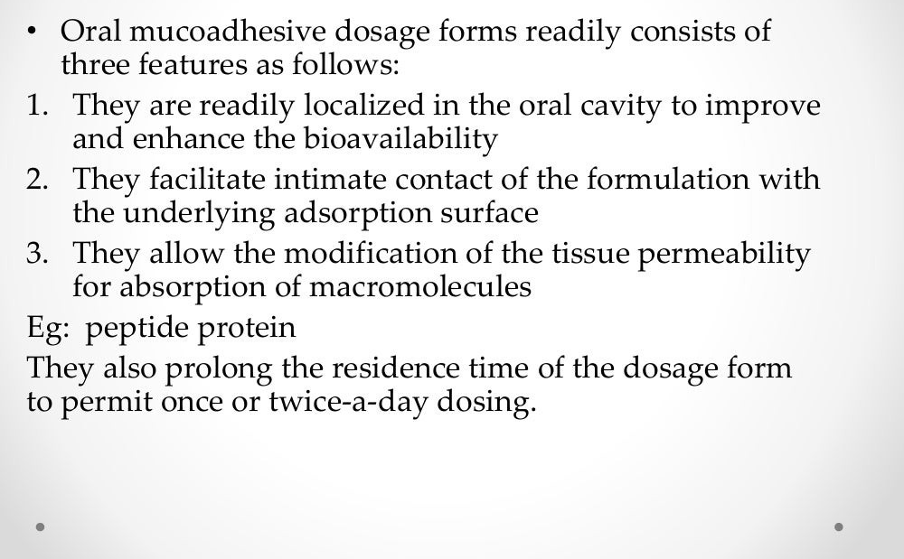

Slide 20
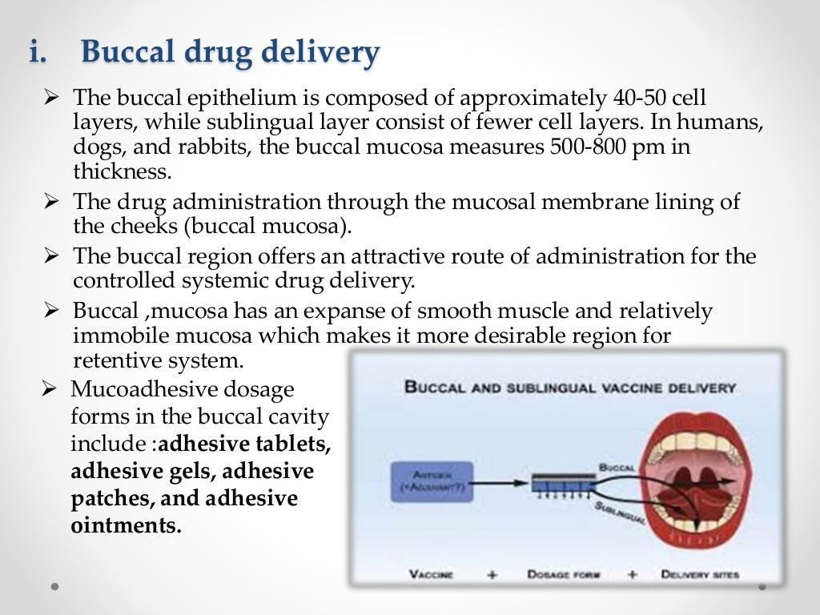

Slide 21
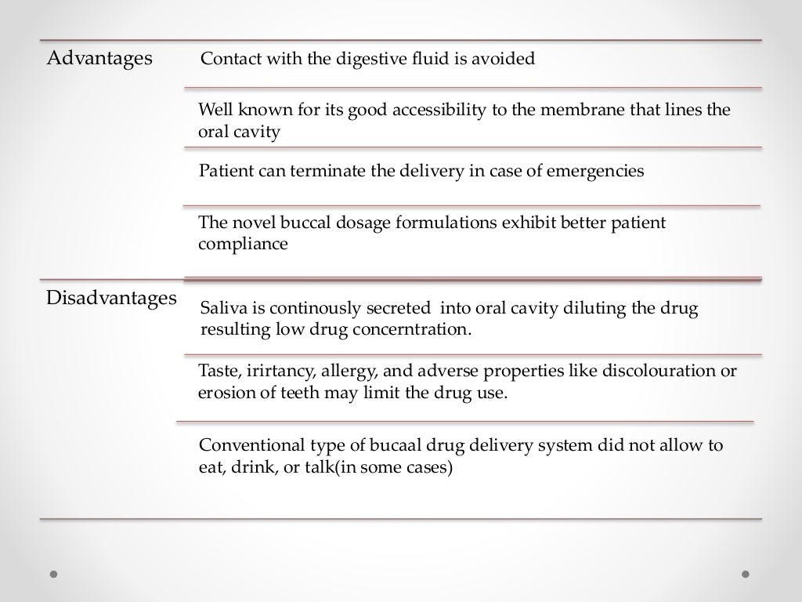

Slide 22
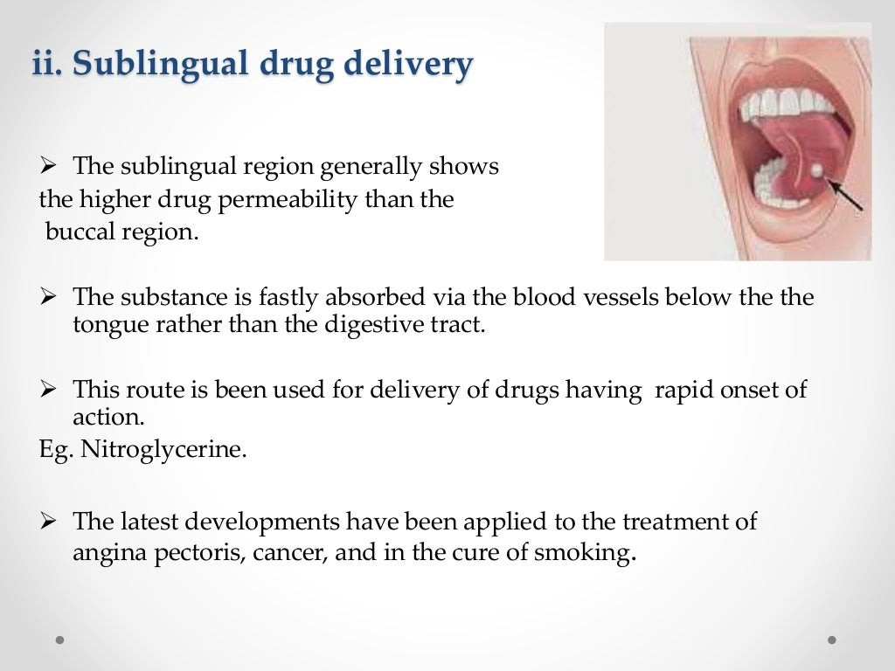

Slide 23
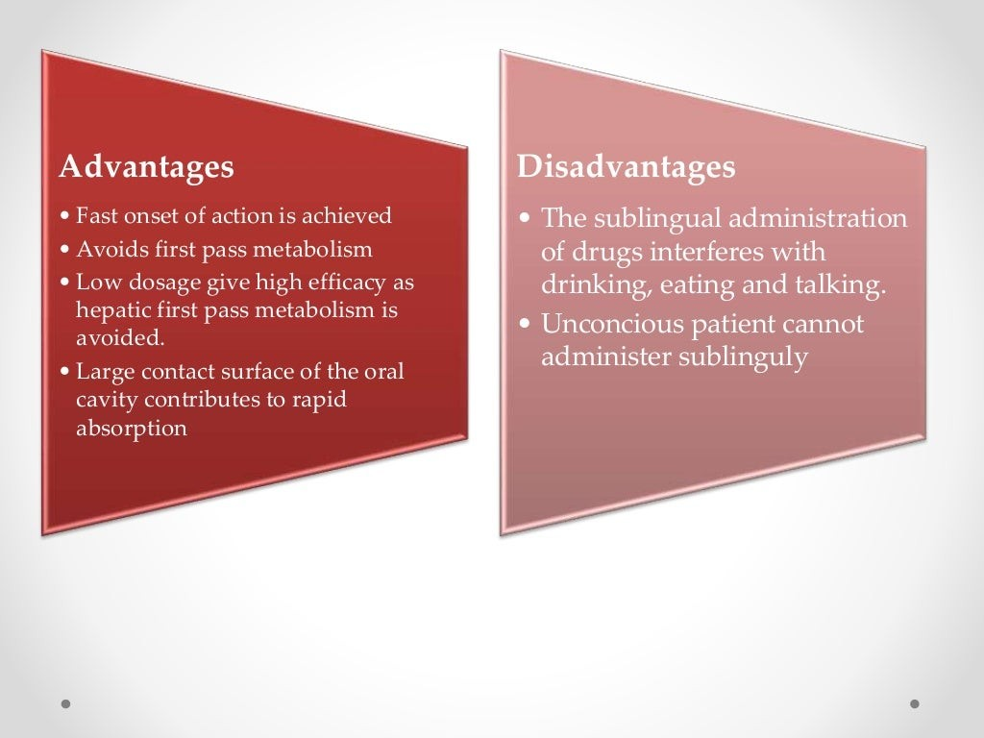

Slide 24
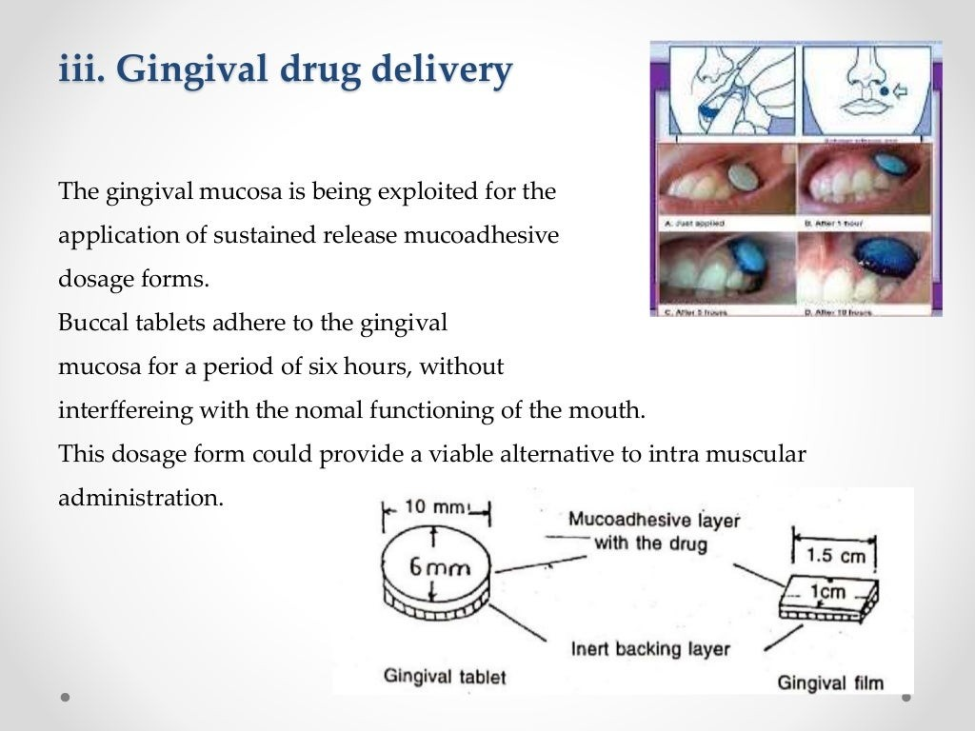

Slide 25
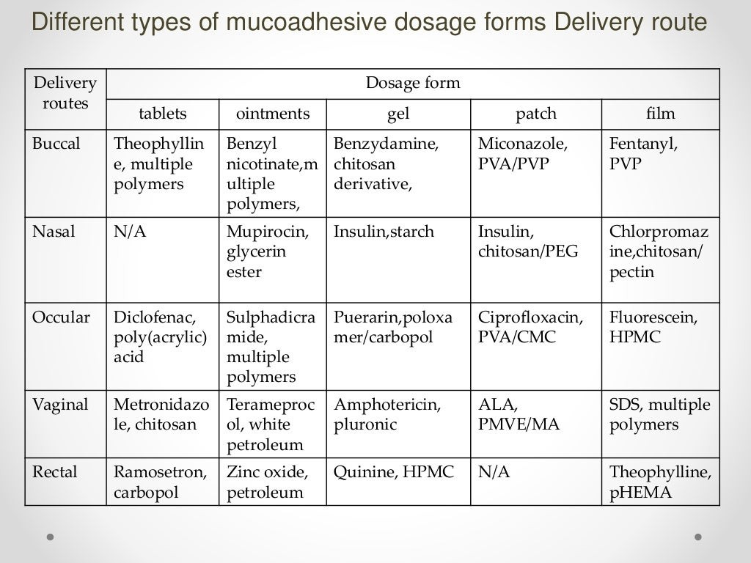

Slide 26
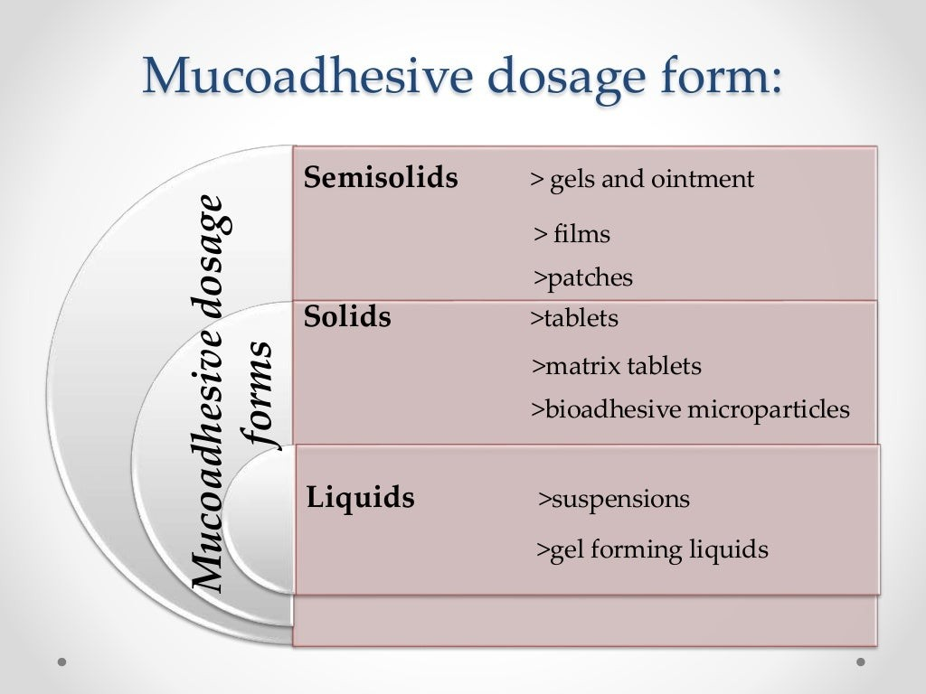

Slide 27
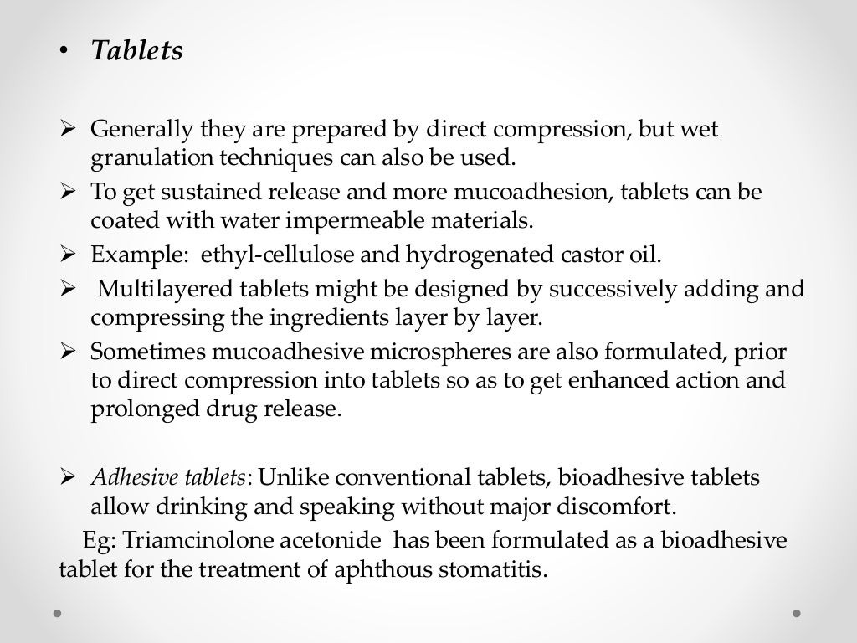

Slide 28
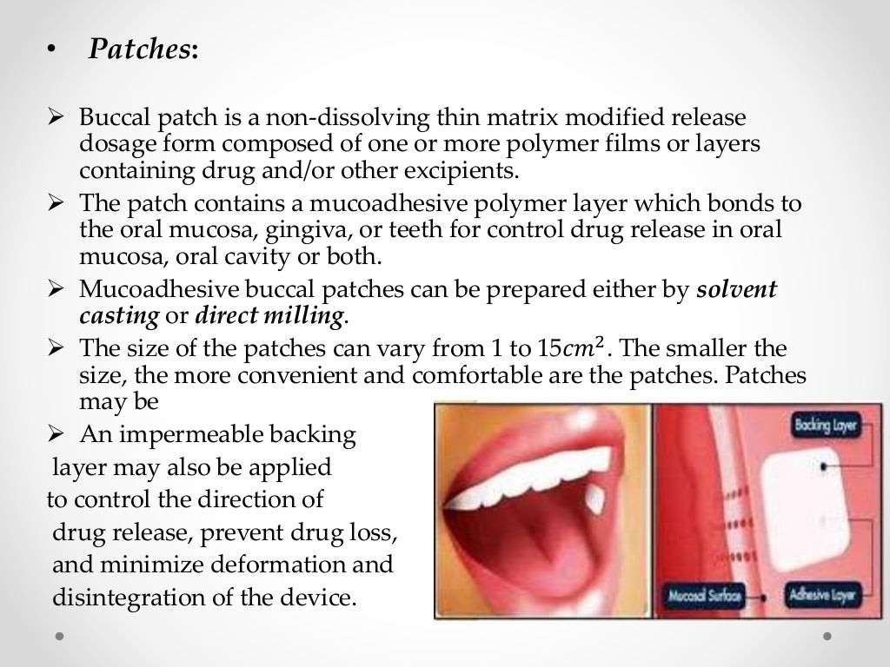

Slide 29
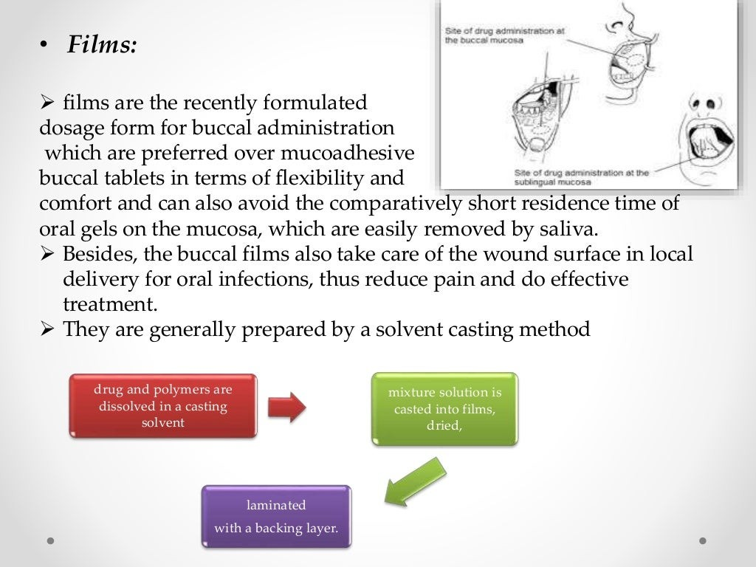

Slide 30
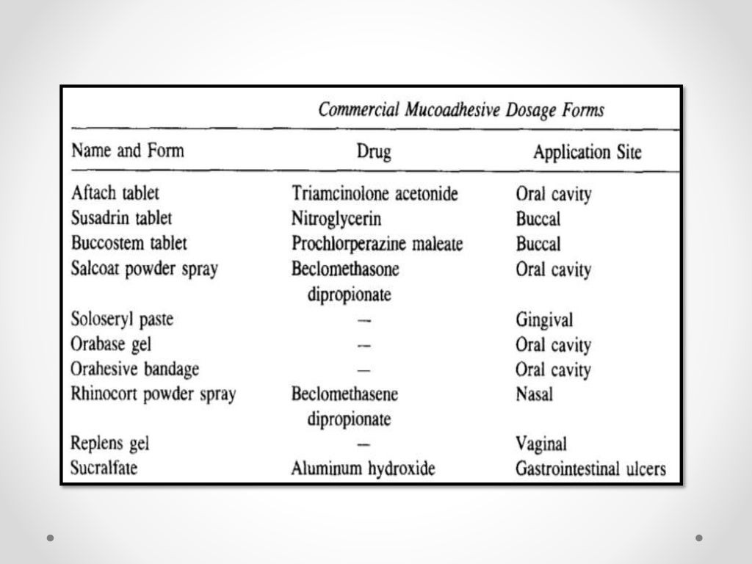

Slide 31
