Slide 1
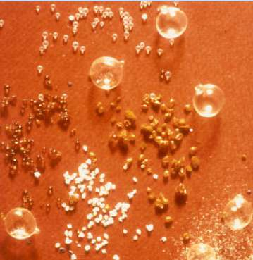
MICROENCAPSULATION
Dr. Hemant Yadav

Slide 2
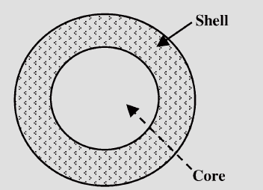
Microencapsulation:
Definition: It is the process by which individual particles or droplets of solid or liquid material (the core) are surrounded or coated with a continuous film of polymeric material (the shell) to produce capsules in the micrometer to millimetre range, known as microcapsules.

Slide 3
Fundamental Consideration
Generally Micro particles consist of two components
a) Core material.
b) Coat or wall or shell material

Slide 4
REASONS FOR ENCAPSULATION
The core must be isolated from its surroundings, as
1. To protect reactive substances from the environment,
2. To convert liquid active components into a dry solid system,
3. To separate incompatible components for functional reasons,
4. To protect the immediate environment of the microcapsules from the active components.

Slide 5
To control the rate at which it leaves the microcapsule, as
1. To control release of the active components for delayed (timed) ….release or long-acting (sustained) release,
2. The problem may be as simple as masking the taste or odor of ….the core,
3. To Increase of bioavailability,
4. To produce a targeted drug delivery,
5. Protects the GIT from irritant effects of the drug,

Slide 6
Drawbacks
1.non uniform coating
2. expensive
3. skill required
4. size control

Slide 7
Core Material
The material to be coated. It may be liquid or solid or gas. Liquid core may be dissolved or dispersed material.
Composition of core material:
▪ Drug or active constituent
▪ Additive like diluents
▪ Stabilizers

Slide 8
Morphology of Microcapsules:
The morphology of microcapsules depends mainly on the core material and the deposition process of the shell.
1- Mononuclear (core-shell) microcapsules contain the shell around the core.
2- Polynuclear capsules have many cores enclosed within the shell.
3- Matrix encapsulation in which the core material is distributed homogeneously into the shell material.
- In addition to these three basic morphologies, microcapsules can also be mononuclear with multiple shells, or they may form clusters of microcapsules.

Slide 9
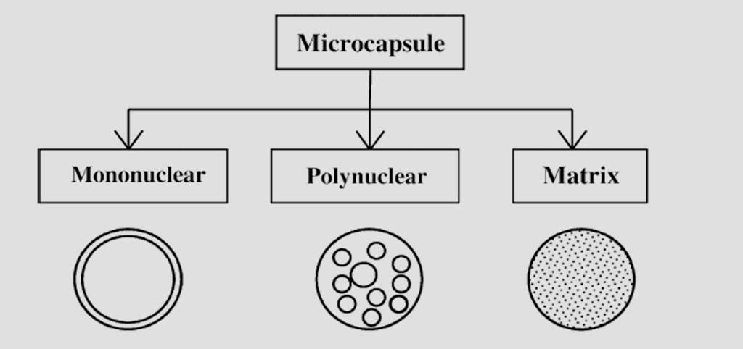

Slide 10
Coating material properties:
•Stabilization of core material.
•Inert toward active ingredients.
•Controlled release under specific conditions.
•Film-forming, pliable, tasteless, stable.
•Non-hygroscopic, no high viscosity, economical.
•Soluble in an aqueous media or solvent, or melting.
•The coating can be flexible, brittle, hard, thin etc.

Slide 11
Coating materials:
Gums: Gum arabic, sodium alginate, carageenan.
Carbohydrates: Starch, dextran, sucrose
Celluloses: Carboxymethylcellulose, methycellulose.
Lipids: Bees wax, stearic acid, phospholipids.
Proteins: Gelatin, albumin.

Slide 12
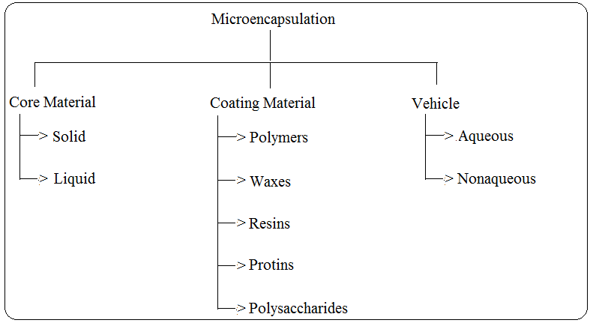
Fig.: Type of Core materials, Coting materials and Vehicles used in Microencapsulation.

Slide 13
Core Material | Characteristic Property | Purpose of Encapsulation | Final Product Form
Aspirin | Slightly water- soluble solid | Taste-masking; sustained release; reduced gastric irritation; separation of incompatibles | Tablet or capsule
Vitamin A Palmitate | Nonvolatile liquid | Stabilization to oxidation | Dry powder
Isosorbide dinitrate | Water soluble solid | sustained release | Capsule
Properties of Some Microencapsulated Core Materials.

Slide 14
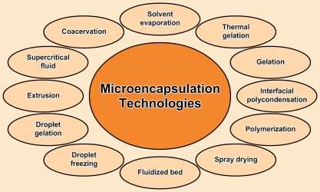
Microencapsulation
Technologies

Slide 15
Techniques To Manufacture
1. Physical methods
1.1 Air-suspension coating
1.2 Coacervation Process
1.3 Pan coating
1.4 Multiorifice Centrifugation Process
1.5 Spray–drying & spray congealing
2. Chemical process
2.1 Solvent Evaporation
2.2. Polymerization
15

Slide 16
1. Physical Methods
1.1Air-suspension
Inventions of Professor Dale E. Wurster
Basically the wurster process consists of the dispersing of solid, particulate core materials in a supporting air stream and the spray-coating of the air suspended particles.
Micron or submicron particles can be effectively encapsulated by air suspension techniques.
Disadvantage- Agglomeration of the particles to some larger size is normally achieved.

Slide 17
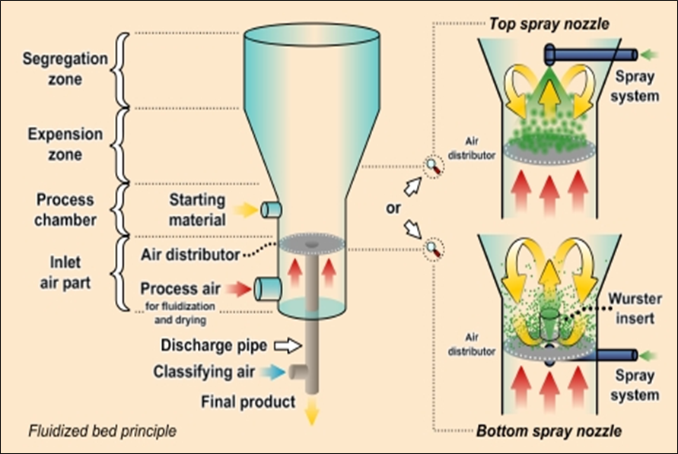
Fig.: Air Suspension Apparatus.

Slide 18
1.2 Coacervation phase separation
The general process consist of 3 steps under continuous agitation:
Formation of 3 immiscible chemical phase
Deposition of coating
Rigidization of coating.
PHASE
SEPARATION
Homogeneous
Polymer Solution
Droplets
Coacervate
Droplets
MEMBRANE
FORMATION
Polymeric
Membrane
18

Slide 19
Step: 1) Three immiscible phases are as:
a) Liquid manufacturing vehicle phase
b) Core material phase
c) Coating material phase.
Coating material phase formed by utilizing following methods:
A) Temperature change.
B) By addition of incompatible polymer
C) By non-solvent addition.

Slide 20
Types of Coacervation-Phase Separation
I. Simple Coacervation
Ø It includes a simple coacervation process in which microencapsulation is carried out by using water as the solvent phase and a water-soluble polymer as the coating material. Coacervation is induced by the addition of a soluble salt.
Ø Example: An oily material Vitamin A Palmitate is micro-encapsulated in gelatin by adding a water-soluble salt.

Slide 21
II. COMPLEX COACERVATION
This method is based on the ability of cationic and anionic water-soluble polymers to interact in water to form a liquid, polymer-rich phase called a complex coacervate.
Gelatin is normally the cationic polymer used. A variety of natural and synthetic anionic water-soluble polymers interact with gelatin to form complex coacervates suitable for encapsulation.
→ This technology usually produces single capsules of 20-800 μm diameter that contain 80-90% by weight core material.

Slide 22
Ø If a water-insoluble core material is dispersed in the system and the complex coacervate wets this core material, each droplet or particle of dispersed core material is spontaneously coated with a thin film of coacervate.
Ø When this liquid film is solidified, microcapsules are formed.

Slide 23
NON-SOLVENT ADDITION TECHNIQUE
→ These processes are designed to produce microcapsules of solids that are insoluble in the solvent – non-solvent pairs.
Method:
Ø In this process, phase separation is induced by the addition of a non-solvent to a solution of a polymer.
Ø The ability of the non-solvent to cause the polymer to separate is measured by the solubility parameter. As the solubility parameter of the non-solvent and the polymer surpasses 1.1, liquid phase separation occurs.
Ø When a core material wettable by the polymer is present, microcapsules are formed.

Slide 24
TEMPERATURE CHANGE
TECHNIQUE
Method:
Ø This process involves a polymer soluble in a solvent at elevated temperature but insoluble in the same solvent at room temperature.
Ø When certain polymers are dispersed in a cold solvent with a core material present, heating the mixture with agitation to a selected temperature and slowly cooling the dispersion back to room temperature can result in microencapsulation.
Ø For example: Water-insoluble liquids can be microencapsulated in methylcellulose from water, and water-soluble solids can be microencapsulated in ethylcellulose from cylcohexane.

Slide 25
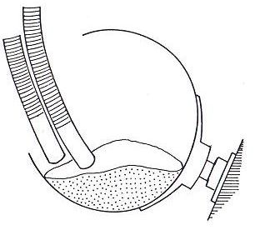
1.3 Pan coating
Solid particle greater than 600 micron size are generally consider for effective coating.
It is used for preparation of controlled- release beads.
Coating is applied as solution by automized spray to desired solid core material in coating pan.
Usually warm air is passed over the coated material as the coating are being applied in the coating pan.
Figure Pan coater

Slide 26
1.5 Spray-Drying & spray-congealing :
- Microencapsulation by spray-drying is a low-cost commercial process which is mostly used for the encapsulation of fragrances, oils and flavors.
Steps:
1- Core particles are dispersed in a polymer solution and sprayed into a hot chamber.
2- The shell material solidifies onto the core particles as the solvent evaporates.
- The microcapsules obtained are of polynuclear or matrix type.

Slide 27
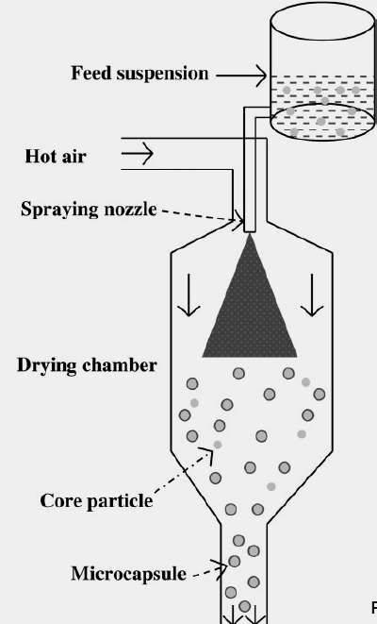

micro-encapsulation by spray-drying.

Slide 28
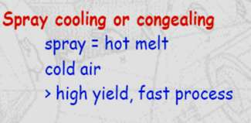
Spray-congealing:
- This technique can be accomplished with spray drying equipment when the protective coating is applied as a melt.
1- the core material is dispersed in a coating material melt.
2- Coating solidification (and microencapsulation) is accomplished by spraying the hot mixture into a cool air stream.
- e.g. microencapsulation of vitamins with digestable waxes for taste masking.

Slide 29
EVALUATION OF MICROCAPSULES
Percentage yield
Scanning electron microscopy
Particle size analysis
Encapsulation efficiency
Amount of drug present In microcapsules
Dissolution test- In vitro drug release

Slide 30
Percentage yield
The total amount microcapsules obtained are weighed and the percentage yield calculated taking into consideration the weight of drug and polymer
Percentage yield = amt of microcapsule obtained/ theoretical amt X 100
Scanning electron microscopy
Small amount of microcapsules are spread on gold stub and placed in the scanning electron microscopy chamber (SEM). The SEM photomicrographs are taken at the acceleration voltage of 20KV.

Slide 31
Particle size analysis
For size distribution analysis, different sizes in a batch are separated by sieving by using set of standard sieves. The amounts retained on different sieves are weighed.
Encapsulation efficiency
Encapsulation effiencency was calculated using the formula:
Encapsulation efficiency = actual drug content/theoretical drug content *100

Slide 32
Applications
Pharmaceutical Applications
To improve the flow properties. e.g. Thiamine, Riboflavine
To enhance the stability. e.g. Vitamins
To reduce the volatility of materials. e.g. Peppermint oil, Methyl salicylate
To avoid incompatibilities. e.g. Aspirin and Chloramphenicol
To mask the unpeasant taste and odour. e.g. Aminophylline, castor oil
To convert liquids into solids. e.g. Castor oil, Eprazinone,
To reduce gastric irritation. e.g. Nitrofurantoin, Indomethacin
32

Slide 33
Food Industry
Adding ingredients to food products to improve nutritional value can compromise their taste, colour, texture and aroma.
Sometimes they slowly degrade and lose their activity, or become hazardous by oxidation reactions.
Ingredients can also react with components present in the food system, which may limit bioavailability.

Slide 34
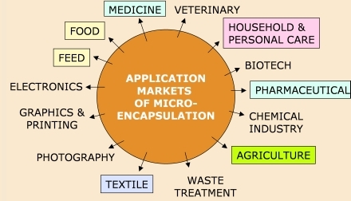
APPLICATION OF MICROENCAPSULATION TECHNIQUES:

