Slide 1
Data Collection
Prof Savita Sheoran
Indira Gandhi University Meerpur, Rewari

Slide 2
Defination
Data collection is the first step in the data science workflow. It involves gathering raw data from various sources to be processed, analyzed, and used for decision-making. The quality and reliability of insights depend heavily on how well the data is collected.

Slide 3
Types of Data Collection in Data Science
Type | Description | Examples
1. Structured Data | Well-organized data stored in tabular format (databases, spreadsheets). | SQL databases, CRM systems, CSV files.
2. Unstructured Data | Raw, unorganized data that requires processing. | Text data, social media posts, emails.
3. Semi-structured Data | Partially organized data with tags or metadata. | JSON, XML files, log files.
4. Real-time Data | Continuously generated and processed data streams. | IoT sensor data, stock market feeds.

Slide 4
Sources of Data Collection
Source | Description | Examples
1. Databases | Data stored in structured format, accessed via SQL. | MySQL, PostgreSQL, MongoDB.
2. APIs (Application Programming Interfaces) | Interfaces to fetch real-time or external data. | Twitter API, Google Maps API.
3. Web Scraping | Extracting data from websites using automated scripts. | Scraping product prices from Amazon.
4. Sensors & IoT Devices | Collecting real-time data from smart devices. | Temperature sensors, fitness trackers.
5. Logs & System Data | Data generated by software applications. | Server logs, event tracking logs.
6. Surveys & Questionnaires | Collecting user feedback and opinions. | Google Forms, customer feedback surveys.
7. Open Data Sources | Publicly available datasets. | Kaggle, UCI Machine Learning Repository, government databases.

Slide 5
Challenges in Data Collection
Data Quality Issues – Incomplete, inconsistent, or incorrect data.
✅ Privacy & Security Concerns – Ensuring compliance with data protection laws (GDPR, CCPA).
✅ Data Volume & Storage – Managing large-scale data efficiently.
✅ Access Restrictions – Some data sources require permissions or paid access.

Slide 6
Understanding Data Collection Methods
Quantitative Methods:These methods involve collecting numerical data for statistical analysis, enabling objective measurement.
Qualitative Methods Qualitative methods focus on gathering non-numerical insights to better understand experiences and motivations.
Mixed MethodsMixed methods combine both quantitative and qualitative approaches, providing a comprehensive understanding of research subjects.
Selection CriteriaThe choice of data collection method is influenced by research goals, data availability, and resource constraints.

Slide 7
Primary Data Collection Techniques
Surveys and QuestionnairesUsed to gather data directly from respondents to understand opinions and behaviors.
Interviews Involves one-on-one discussions for in-depth insights and personal opinions.
Experiments Controlled studies to observe the effects of specific variables on outcomes.
Observations Directly witnessing behaviors or events in real-time to gather qualitative data.
Example Application Using surveys to assess user satisfaction in product development projects.

Slide 8
Exploring Secondary Data Techniques
Existing Databases Utilizing data collected by organizations or past studies for insights.
Literature Review Analyzing published research and reports to gather relevant information.
Web Scraping Extracting data from online sources to facilitate comprehensive analysis.
Public Datasets Leveraging freely available datasets like government data for research.
Example Usage Analyzing census data to understand demographic trends for marketing strategy.

Slide 9
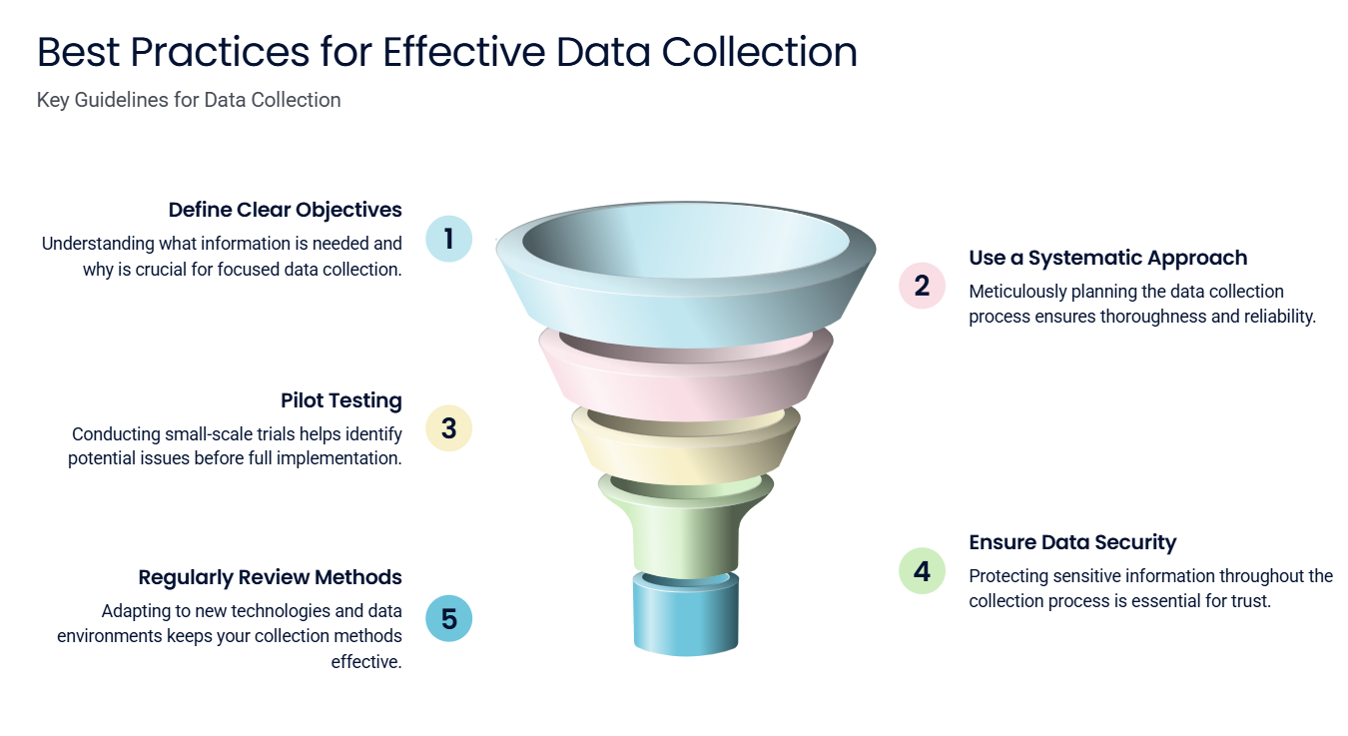

Slide 10
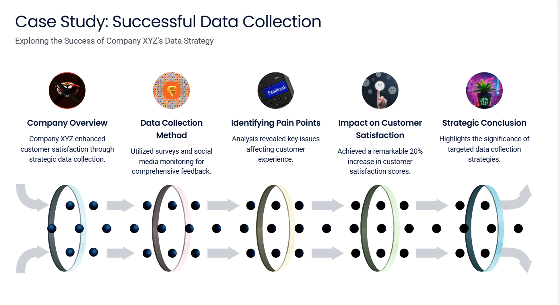

Slide 11
