Slide 1
Visualizing Data: Bar Charts, Line Charts, Scatterplots
Prof. Savita Sheoran
Indira Gandhi University Meerpur

Slide 2
Visualizing Data
Visualizing data is a powerful way to communicate insights clearly and effectively. Bar charts, line charts, and scatterplots are some of the most common types of data visualizations used for different purposes. Here's a breakdown of each one:
Bar Charts
  Purpose: Bar charts are used to compare different categories or groups of data.
  Structure: Consists of bars where the length (or height) of each bar represents the value of a specific category.
  When to Use:
    Comparing quantities across different categories.
    Visualizing data that has distinct categories (e.g., sales by region, population by country, etc.).
  Types:
    Vertical bar chart: Bars go up or down.
    Horizontal bar chart: Bars go left or right.
  Example: Comparing the sales of different products.

Slide 3
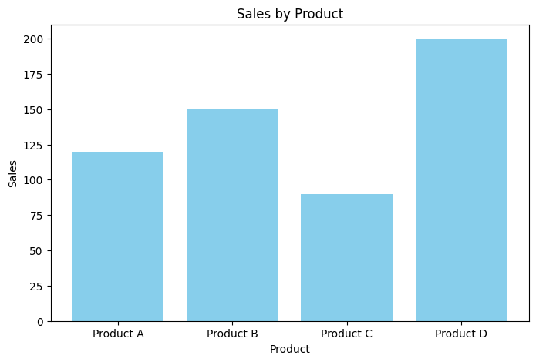
Bar Chart
import matplotlib.pyplot as plt
# Sample data
categories = ['Product A', 'Product B', 'Product C', 'Product D']
sales = [120, 150, 90, 200]
# Create bar chart
plt.figure(figsize=(8, 5))
plt.bar(categories, sales, color='skyblue')
# Add titles and labels
plt.title('Sales by Product')
plt.xlabel('Product')
plt.ylabel('Sales')
# Show the chart
plt.show()

Slide 4
Line Charts
Purpose: Line charts are ideal for showing trends over time or continuous data.
Structure: Consists of points connected by straight lines, representing data over a continuous variable (usually time).
When to Use:
  To show the trend of a variable over time.
  Comparing multiple data series over time.
Types:
  Single line chart: For showing a single data series.
  Multiple line chart: For showing multiple data series.
Example: Tracking the temperature over the course of a week.

Slide 5
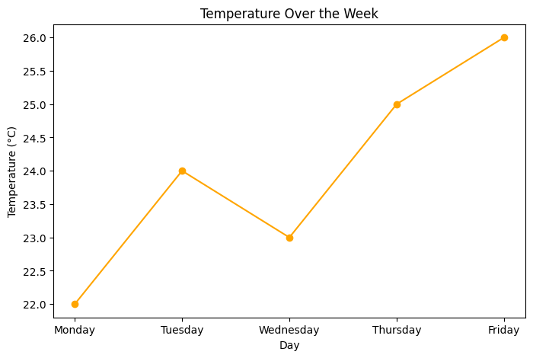
import matplotlib.pyplot as plt
# Sample data
days = ['Monday', 'Tuesday', 'Wednesday', 'Thursday', 'Friday']
temperatures = [22, 24, 23, 25, 26]
# Create line chart
plt.figure(figsize=(8, 5))
plt.plot(days, temperatures, marker='o', color='orange')
# Add titles and labels
plt.title('Temperature Over the Week')
plt.xlabel('Day')
plt.ylabel('Temperature (°C)')
# Show the chart
plt.show()

Slide 6
Scatterplots
Purpose: Scatterplots are used to show the relationship between two continuous variables.
Structure: Each point on the plot represents an individual data point, with its position determined by the values of two variables.
When to Use:
  To identify patterns, correlations, or trends between two variables.
  Spotting outliers or clusters in the data.
Types:
  Simple scatterplot: Shows the relationship between two variables.
  Bubble chart: A variation where a third variable is represented by the size of the dots.
Example: Visualizing the relationship between study time and test scores.

Slide 7
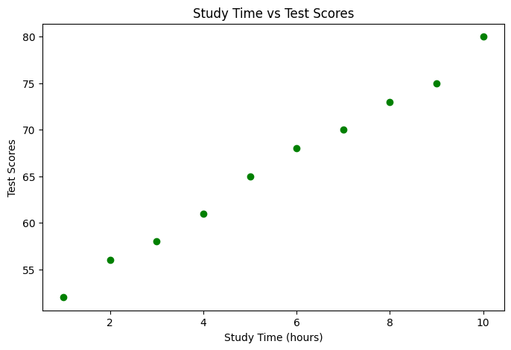
Example
import matplotlib.pyplot as plt
# Sample data
study_time = [1, 2, 3, 4, 5, 6, 7, 8, 9, 10]
test_scores = [52, 56, 58, 61, 65, 68, 70, 73, 75, 80]
# Create scatterplot
plt.figure(figsize=(8, 5))
plt.scatter(study_time, test_scores, color='green')
# Add titles and labels
plt.title('Study Time vs Test Scores')
plt.xlabel('Study Time (hours)')
plt.ylabel('Test Scores')
# Show the chart
plt.show()

