Slide 1
Analysis
Prof Savita Sheoran
Indira Gandhi University Meerpur, Rewari

Slide 2
Introduction
In the realm of data science, analysis and reporting are two fundamental aspects of the data workflow. While they are often used interchangeably, they serve distinct purposes and require different approaches. The key differences, processes, and roles of analysis and reporting in data science, shedding light on how they complement each other to turn raw data into valuable insights that drive decision-making.

Slide 3
Analysis
The goal of the analysis is to explore the data, uncover patterns, identify relationships, and gain insights that inform decision-making or hypothesis testing. It's about understanding the "why" behind the data.
Activities
  Data cleaning and pre-processing: The raw data contains missing values for some customers' ages and some entries where the date of purchase is incorrect
  In this step, you'd clean the data by filling in missing age values (perhaps using the median value for those missing entries) and correcting date anomalies (e.g., correcting purchase dates that are in the future).

Slide 4
Analysis
  import pandas as pd
  # Example dataset
  df = pd.DataFrame({ 'CustomerID': [1, 2, 3, 4, 5],
  'Name': ['Alice', 'Bob', 'Charlie', 'David', 'Eva'],
  'Age': [25, None, 30, None, 22]})
  # Drop rows with missing values in the 'Age' column
  df_cleaned = df.dropna(subset=['Age'])
  print(df_cleaned)
Filling missing values: When removing rows or columns with missing data is not a good option (for example, if the missing data is too widespread), filling missing values with a specific value can help.
Example: For missing "Age" values, you might fill in the missing data with the mean or median value of the existing data.

Slide 5
Cont..
  median_age = df['Age'].median()
  df['Age'] = df['Age'].fillna(median_age) print(df)
Removing Duplicates: Duplicate records are common in large datasets, especially when data is collected from multiple sources. Identifying and removing duplicates ensures the integrity of the dataset.
  df = pd.DataFrame({
  'CustomerID': [1, 2, 2, 4, 5],
  'Name': ['Alice', 'Bob', 'Bob', 'David', 'Eva'],
  'Age': [25, 30, 30, 40, 22] }) # Remove duplicate rows
  df_no_duplicates = df.drop_duplicates() print(df_no_duplicates)

Slide 6
Cont..
Handling Incorrect Data Types
  Sometimes, data might not be in the right format or data type. For instance, numbers might be stored as strings or dates might not be recognized as dates. Converting these into the appropriate types is crucial.
  Example:
  # Example dataset
  df = pd.DataFrame({ 'CustomerID': [1, 2, 3],
  'DateOfBirth': ['1990-01-01', '1985-05-15', '2000-11-30']})
  # Convert 'DateOfBirth' to datetime type
  df['DateOfBirth'] = pd.to_datetime(df['DateOfBirth'])
  print(df)

Slide 7
Data Pre-processing
Once the data is cleaned, the next step is pre-processing. This step is about transforming data into a format or structure that is suitable for analysis or modeling. Pre-processing can include feature scaling, encoding categorical variables, and feature engineering.
Feature scaling is important when features have different units or ranges. Some machine learning algorithms (e.g., KNN, SVM, or gradient descent-based algorithms) are sensitive to the scale of the data.
Example: You have two features: Age (ranging from 18 to 100) and Income (ranging from 30,000 to 200,000)
You can use standardization (scaling features to have mean 0 and standard deviation 1) or normalization (scaling features to a range, usually 0 to 1)

Slide 8
Data Pre-processing
Encoding Categorical Variables:Many machine learning algorithms require numerical input, so categorical variables need to be encoded. Common methods include one-hot encoding and label encoding.
Example:Suppose you have a "Gender" column with values "Male" and "Female". You can encode this using one-hot encoding
  # Example dataset
  df = pd.DataFrame({'CustomerID': [1, 2, 3],
  'Gender': ['Male', 'Female', 'Female']})
  # One-hot encoding the 'Gender' column
  df_encoded = pd.get_dummies(df, columns=['Gender'], drop_first=True)
  print(df_encoded)

Slide 9
Processing in Data Science
Processing in Data Science refers to the steps involved in cleaning, transforming, and preparing raw data for analysis and modeling. It ensures that the data is accurate, consistent, and suitable for extracting insights

Slide 10
Stages of Data Processing in Data Science
Stage | Description | Example
1. Data Collection | Gathering raw data from various sources like databases, APIs, sensors, or files. | Fetching customer transaction data from an SQL database.
2. Data Cleaning | Removing inconsistencies, missing values, and duplicate entries. | Handling missing values by filling with mean/median or dropping them.
3. Data Transformation | Converting data into a suitable format, normalizing, or encoding categorical values. | Converting "Yes/No" into binary (1/0) or normalizing numerical features.
4. Data Integration | Merging data from multiple sources for a unified dataset. | Combining sales data from different branches into a central database.
5. Data Reduction | Reducing dataset size by eliminating redundant features or using dimensionality reduction techniques. | Using PCA (Principal Component Analysis) to reduce high-dimensional data.
6. Data Exploration | Performing initial analysis, identifying patterns, and visualizing data distributions. | Using Pandas, Matplotlib, or Seaborn to explore correlations in a dataset.
7. Feature Engineering | Creating new features from existing ones to improve model performance. | Extracting "day of the week" from a date column for sales forecasting.

Slide 11
Analysis
The goal of the analysis is to explore the data, uncover patterns, identify relationships, and gain insights that inform decision-making or hypothesis testing. It's about understanding the "why" behind the data.
  Exploratory Data Analysis (EDA) to identify trends, outliers, correlations, etc
    What is the average age of customers who make a purchase?
    "Is there a pattern to the time of day when most purchases occur?
    “Do certain customer segments (e.g., young adults, seniors) spend more on average?"
  Statistical analysis (e.g., hypothesis testing, regression analysis)
  Building models (e.g., machine learning models) to make predictions or classifications
  Drawing conclusions from the data and testing assumptions

Slide 12
Exploratory Data Analysis
  Exploratory Data Analysis (EDA) to identify trends, outliers, correlations, etc
    What is the average age of customers who make a purchase?
    "Is there a pattern to the time of day when most purchases occur?
    “Do certain customer segments (e.g., young adults, seniors) spend more on average?"
  To explore these, you might visualize the data using histograms or scatter plots, and calculate summary statistics (e.g., mean, median, standard deviation).
Example Insights from EDA:
  Customers aged 18-34 make up 40% of all purchases, while customers aged 45-60 contribute 25%.
  Most purchases occur between 6 p.m. and 10 p.m.

Slide 13
Main key steps of EDA
Data Cleaning and Preprocessing:
  Handling missing values.
  Identifying and removing duplicates.
  Detecting outliers or incorrect data entries.
Data Transformation:
  Normalizing or scaling features.
  Converting categorical variables into numerical ones (e.g., via encoding).
Univariate Analysis (Single Variables):
  Summary statistics: mean, median, standard deviation, etc.
  Visualizations: histograms, boxplots, and bar charts for categorical data.
  Identifying the distribution of data (e.g., skewness, kurtosis).

Slide 14
Main key steps of EDA
Bivariate/Multivariate Analysis (Relationships between Variables):
  Correlation: Check for relationships between numerical variables (e.g., using Pearson or Spearman correlation).
  Visualizations: scatter plots, pair plots, heatmaps.
  Checking for multicollinearity (in regression problems, for example).
Feature Engineering:
  Creating new features based on existing ones.
  Reducing dimensionality (e.g., via PCA, t-SNE).
Outlier Detection:
  Identifying extreme values that could skew results.
Data Visualization:
  Using charts (e.g., histograms, scatter plots, box plots, violin plots) to identify trends, distributions, and relationships.
Identifying Patterns and Trends:
  Investigating seasonality or cyclical patterns (for time series data).
  Identifying clusters or groups of observations (e.g., via k-means clustering).

Slide 15
Statistical analysis
  It performs more advanced statistical analysis to test hypotheses, such as
    Hypothesis Testing: "Is there a statistically significant difference in spending between male and female customers?
      you would use a t-test to compare the average spending between the two groups and determine if the difference is statistically significant.
    Correlation Analysis: "Is there a correlation between the number of website visits and the amount spent b
      You might find a positive correlation (e.g., a Pearson correlation coefficient of 0.6) indicating that more visits tend to lead to higher spending y customers?"

Slide 16
Statistical analysis
  Statistical analysis involves collecting, interpreting, and presenting data to uncover patterns, relationships, or trends. It’s a way of applying mathematical techniques to analyze and draw conclusions from data. There are various methods within statistical analysis, including:
  Descriptive Statistics: Summarizing data through measures like mean, median, mode, variance, and standard deviation
  Inferential Statistics: Making predictions or inferences about a population based on a sample, often involving hypothesis testing, confidence intervals, and p-values
  Regression Analysis: Understanding relationships between variables. This includes linear regression, logistic regression, etc.
  ANOVA (Analysis of Variance): Comparing means among three or more groups to see if there is a statistically significant difference

Slide 17
Statistical analysis
  Chi-square Test: Examining the relationship between categorical variables.
  Time Series Analysis: Analyzing data points collected or recorded at specific time intervals to identify trends and seasonal patterns.
  Correlation: Measuring the strength and direction of a relationship between two variables.

Slide 18
Descriptive Statistics:
Measures of Central Tendency:
  Mean: The average of all the data points.
  Median: The middle value when the data points are arranged in ascending or descending order.
  Mode: The most frequently occurring value in the dataset.
Measures of Dispersion:
  Range: The difference between the largest and smallest values in the dataset.
  Variance: The average of the squared differences from the mean.
Standard Deviation: The square root of the variance, indicating how spread out the data is around the mean.
Other Measures:
  Skewness: Measures the asymmetry of the distribution of values in the dataset.
  Kurtosis: Describes the "tailedness" or sharpness of the peak of the distribution.

Slide 19
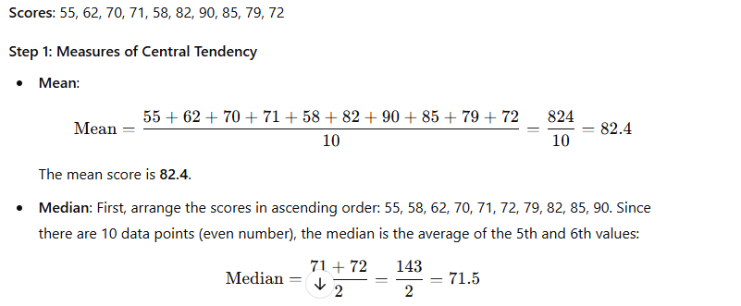
Example:
Mode: The mode is the value that appears most often, but here each score is unique. Hence, there is no mode.

Slide 20
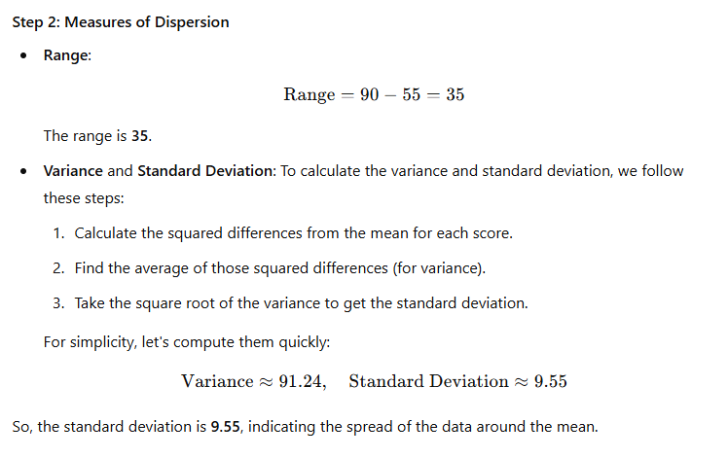

Slide 21
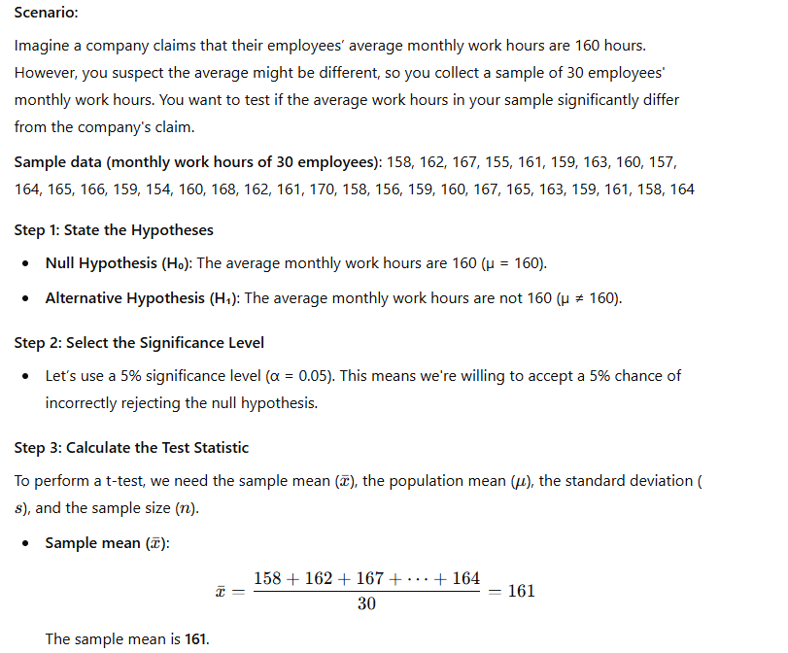
Inferential statistics
Example: Hypothesis Testing (t-test)
Inferential statistics allow you to make predictions or inferences about a population based on a sample of data.
The goal is to use a sample to estimate or test hypotheses about a larger population.
Some common methods in inferential statistics include hypothesis testing, confidence intervals, and regression analysis.

Slide 22
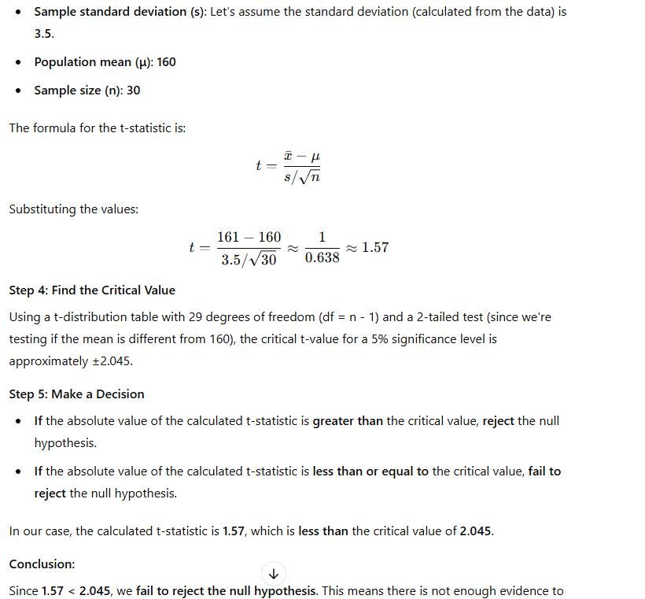
Cont.
Example: Hypothesis Testing (t-test)
Summary
  Null Hypothesis (H₀): µ = 160
  Alternative Hypothesis (H₁): µ ≠ 160
  Calculated t-statistic: 1.57
  Critical t-value: ±2.045
  Decision: Fail to reject the null hypothesis.
conclude that the average monthly work hours differ from 160 hours.

Slide 23
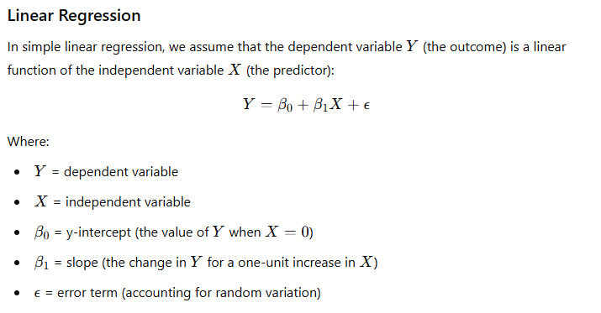
Regression Analysis
Regression analysis is a statistical technique used to understand the relationship between one dependent variable (the outcome) and one or more independent variables (predictors or features). The most common form is linear regression, where we model the relationship as a straight line.

Slide 24
Cont..
Example: Let’s say you're a researcher analyzing the relationship between hours studied (X) and exam scores (Y) for a group of students. You collect the following data:
Hours Studied (X) | Exam Score (Y)
1 | 50
2 | 55
3 | 60
4 | 65
5 | 70
6 | 75
7 | 80

Slide 25
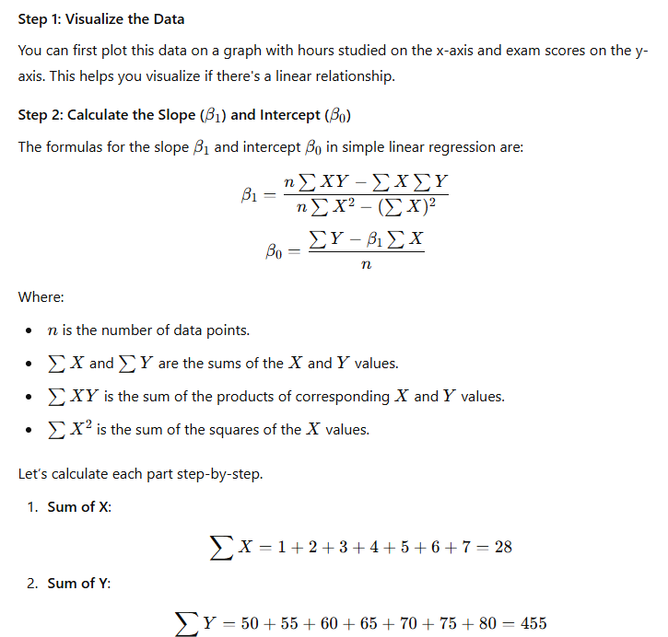

Slide 26
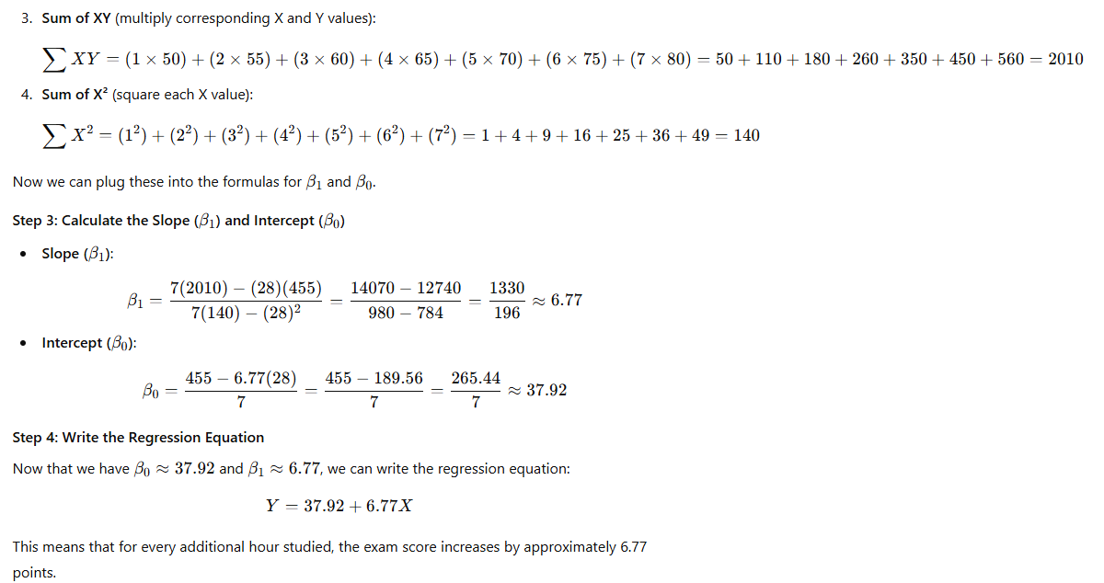

Slide 27
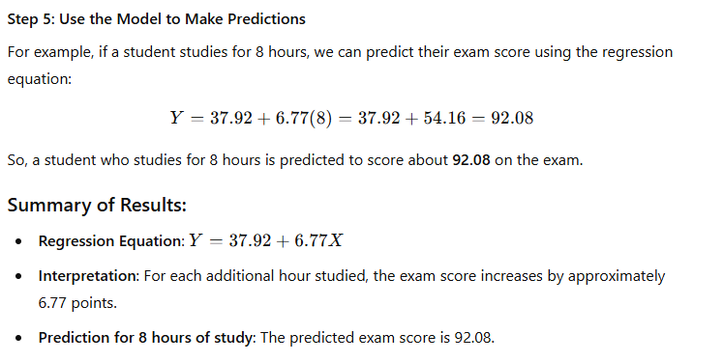

Slide 28
ANOVA
ANOVA (Analysis of Variance) is a statistical technique used to compare the means of three or more groups to determine if there are any statistically significant differences between them. It essentially helps to assess whether the observed variance within each group is greater than the variance between groups, which could suggest real differences between them.
Here are the key components of ANOVA:
Null Hypothesis (H₀): The means of all groups are equal (no effect).
Alternative Hypothesis (H₁): At least one group mean is different from the others.
F-statistic: This is the ratio of the variance between the groups to the variance within the groups. A higher F-statistic suggests greater differences between the group means.
P-value: This tells you if the observed differences are statistically significant. If the p-value is less than a chosen significance level (typically 0.05), the null hypothesis is rejected.
There are several types of ANOVA, including:
One-way ANOVA: Compares the means of three or more independent groups based on one factor.
Two-way ANOVA: Compares the means based on two factors, and also looks at the interaction between these factors.
Repeated measures ANOVA: Used when the same subjects are measured multiple times under different conditions.

Slide 29
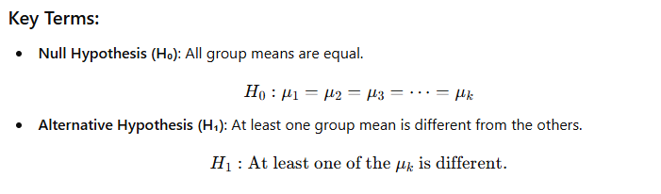
ANOVA
Between-group variance (variance caused by the differences in the means of the groups) should be significantly larger than the within-group variance (variance due to individual differences within each group) if the group means are truly different.
Steps in ANOVA:
Calculate the Mean for Each Group: The average of the values within each group.
Calculate the Grand Mean: The overall mean of all the data combined, treating all the groups as one.
Calculate the Between-Group Variance: How much the group means differs from the grand mean.
Calculate the Within-Group Variance: How much the values within each group deviate from the group mean.
Calculate the F-statistic: A ratio of the between-group variable.
Compare the F-statistic to the Critical Value: If the F-statistic is larger than the critical value (from the F-distribution table), we reject the null hypothesis.

Slide 30
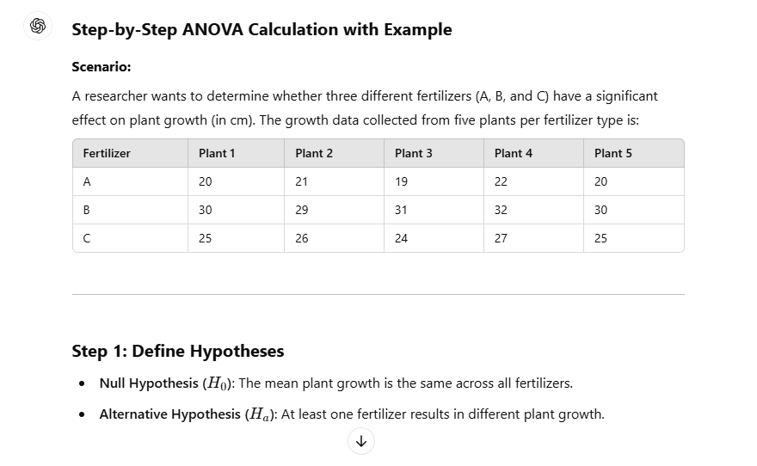
Example of One-Way ANOVA

Slide 31
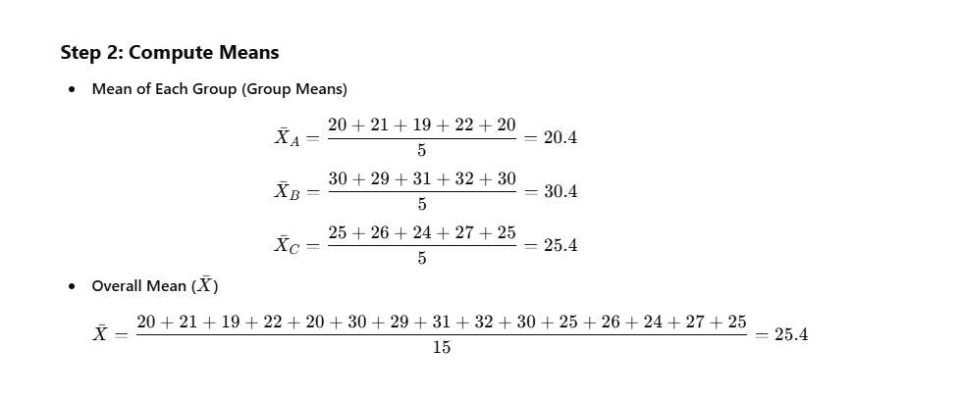

Slide 32
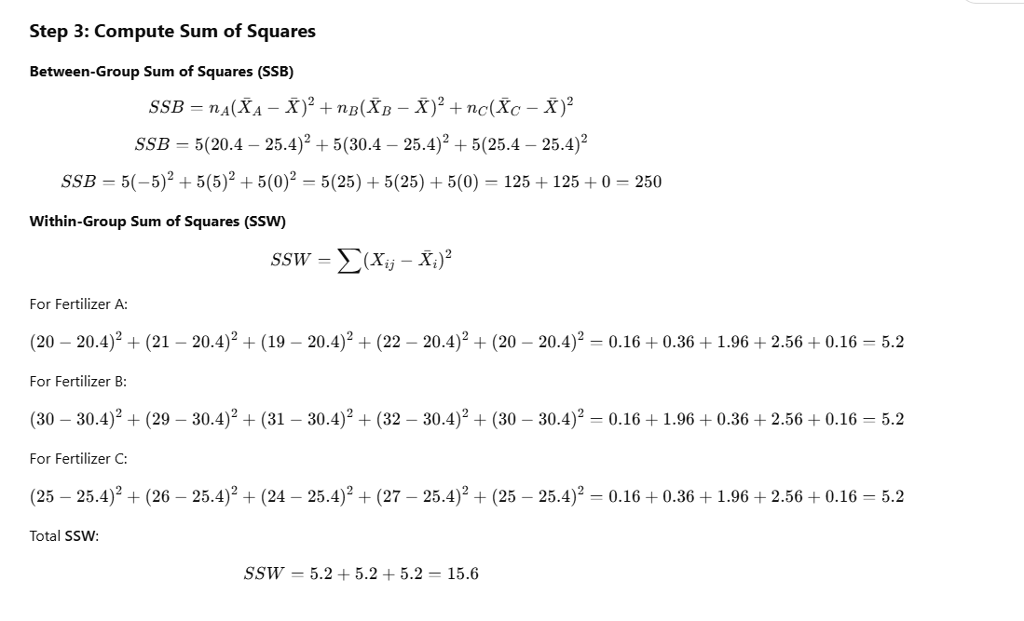

Slide 33
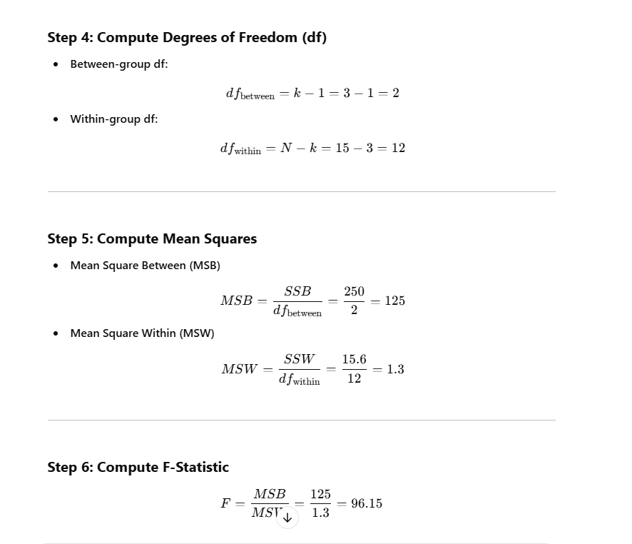

Slide 34
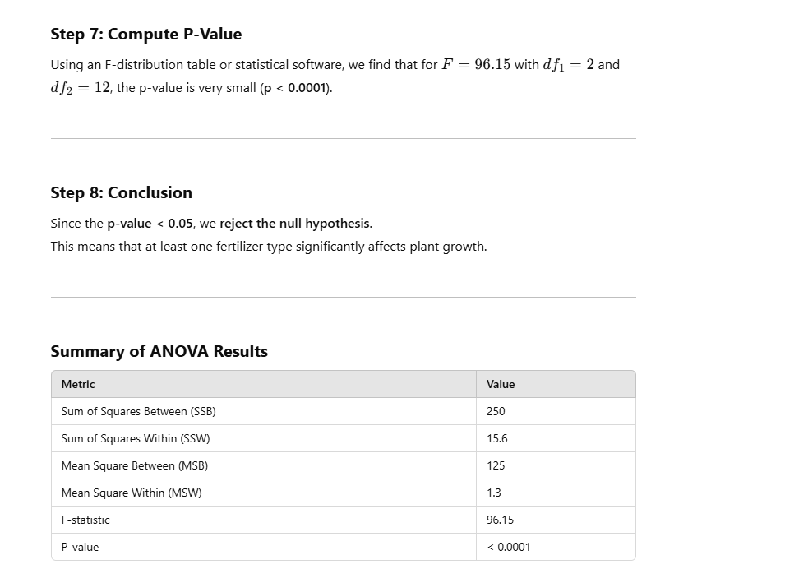

Slide 35
Chi-square Test
The Chi-Square Test is a statistical method used to determine if there is a significant association between two categorical variables. It is commonly used in hypothesis testing. There are two main types:
Chi-Square Goodness of Fit Test – Checks if a sample distribution matches an expected distribution.
Chi-Square Test for Independence – Determines if two categorical variables are independent.
Example: Chi-Square Test for Independence
Let's say a researcher wants to know if gender (Male/Female) is associated with preference for a product (Like/Dislike).

Slide 36
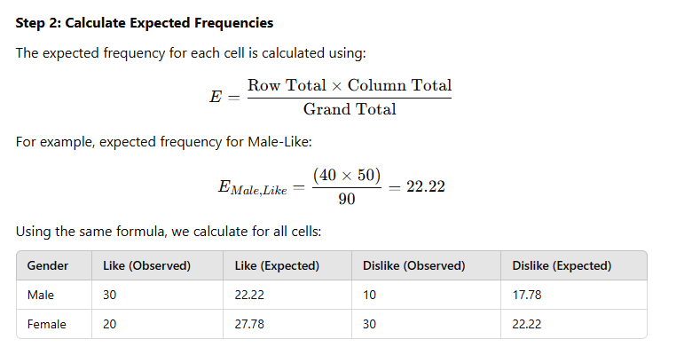
Step 1: Define Hypotheses
Null Hypothesis (H₀): Gender and preference for the product are independent.
Alternative Hypothesis (H₁): Gender and preference for the product are dependent.
Gender | Like | Dislike | Total
Male | 30 | 10 | 40
Female | 20 | 30 | 50
Total | 50 | 40 | 90

Slide 37
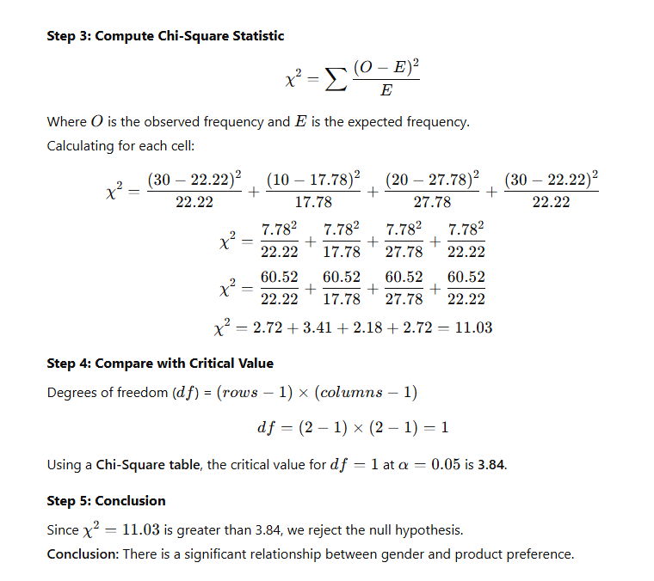

Slide 38
Time Series Analysis in Data Science
What is Time Series Analysis?
Time series analysis is a statistical technique used to analyze time-ordered data points. The goal is to extract meaningful insights, detect trends, seasonality, and forecast future values. Time series data is commonly found in domains like finance, economics, weather forecasting, and stock market analysis.
Key Characteristics of Time Series Data
Temporal Ordering: Data points are collected sequentially over time (e.g., daily sales, monthly temperature
Trends: Long-term upward or downward movement in data
Seasonality: Periodic patterns occurring at regular intervals (e.g., higher sales during holidays
Cyclic Patterns: Fluctuations that do not have a fixed period, influenced by economic or business cycles
Stationarity: A time series is stationary if its statistical properties (mean, variance) remain constant over time.

Slide 39
Time Series Analysis in Data Science
A time series typically consists of the following components:
Trend (T): The general direction in which the data is moving over time.
Seasonality (S): Regular and predictable patterns occurring at fixed intervals.
Cyclic (C): Long-term oscillations influenced by economic or business factors.
Irregular/Residual (R): Random noise or unexpected variations in the data.
The time series can be represented as:
  Y(t)=T(t)+S(t)+C(t)+R(t)

Slide 40
Types of Time Series Models
Moving Averages (MA)
  Used to smooth out short-term fluctuations.
  Helps identify trends.
  Types: Simple Moving Average (SMA) and Exponential Moving Average (EMA).
2. Autoregressive (AR) Model
  Future values depend on past values.
  Example: Yt=ϕ1Yt−1+ϵt​
3. Moving Average (MA) Model
  Future values depend on past forecast errors.
  Example: Yt​=θ1​ϵt−1​+ϵt​
4. ARMA (Autoregressive Moving Average) Model
  Combines AR and MA models.
  Useful for stationary time series.

Slide 41
5. ARIMA (Autoregressive Integrated Moving Average) Model
  Extension of ARMA, used for non-stationary data.
  Involves differencing to make the series stationary.
  Represented as ARIMA(p,d,q)ARIMA(p, d, q)ARIMA(p,d,q):
    ppp: Order of autoregression
    ddd: Degree of differencing
    qqq: Order of moving average
6. Seasonal ARIMA (SARIMA)
  ARIMA extended to handle seasonal effects.
  Represented as SARIMA(p,d,q)×(P,D,Q,s)
7. Exponential Smoothing Methods
  Simple Exponential Smoothing: Suitable for non-trending data.
  Holt’s Linear Trend Model: Handles trends.
  Holt-Winters Method: Handles both trend and seasonality.

Slide 42
Applications of Time Series Analysis
Stock Market Prediction: Predicting future stock prices and trends.
Weather Forecasting: Analyzing temperature, precipitation, and climate changes.
Sales Forecasting: Predicting future demand for a product.
Economic Analysis: Studying inflation, GDP growth, and unemployment rates.
Anomaly Detection: Identifying fraud in transactions, network intrusions, and quality control in manufacturing.

Slide 43
What is Correlation?
Correlation is a statistical measure that expresses the degree of relationship between two numerical variables. It helps determine whether an increase in one variable is associated with an increase or decrease in another.
In data science, correlation is widely used in feature selection, exploratory data analysis (EDA), and predictive modeling.
Types of Correlation
Positive Correlation
  As one variable increases, the other also increases.
  Example: Higher advertising spend leads to higher sales.
  Correlation coefficient (rrr) is between 0 and 1.
Negative Correlation
  As one variable increases, the other decreases.
  Example: Higher speed in a car leads to lower fuel efficiency.
  Correlation coefficient (rrr) is between -1 and 0.
No Correlation
  No relationship between variables.
  Example: The number of hours slept does not affect a person's favorite movie.
  Correlation coefficient (rrr) is close to 0.

Slide 44
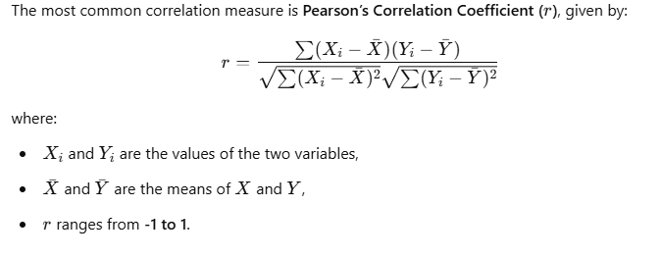
What is Correlation?
Types of Correlation Methods in Data Science
1. Pearson Correlation (Linear Relationship)
Measures the strength and direction of a linear relationship.
Works well when data is normally distributed.
2. Spearman's Rank Correlation
Measures monotonic relationships (not necessarily linear).
Useful when data is not normally distributed or has outliers.
3. Kendall’s Tau Correlation
Measures the strength of association between two ranked variables.
More robust when dealing with small datasets.
4. Point-Biserial Correlation
Used when one variable is continuous and the other is binary (e.g., pass/fail, yes/no).
5. Phi Coefficient (ϕ)
Used to measurethe correlation between two binary variables.

Slide 45
Sample Data: Hours Studied vs. Exam Score
Student | Hours Studied | Exam Score
1 | 1 | 50
2 | 2 | 55
3 | 3 | 65
4 | 4 | 70
5 | 5 | 72
6 | 6 | 75
7 | 7 | 78
8 | 8 | 85
9 | 9 | 88
10 | 10 | 95

Slide 46
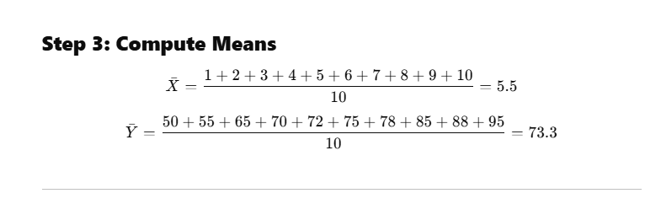
Types of Correlation Methods in Data Science
The Pearson correlation coefficient between "Hours Studied" and "Exam Score" is 0.9878.
1. Pearson Correlation (Linear Relationship)
Measures the strength and direction of a linear relationship.
Works well when data is normally distributed.
2. Spearman's Rank Correlation
Measures monotonic relationships (not necessarily linear).
Useful when data is not normally distributed or has outliers.
3. Kendall’s Tau Correlation
Measures the strength of association between two ranked variables.
More robust when dealing with small datasets.
4. Point-Biserial Correlation
Used when one variable is continuous and the other is binary (e.g., pass/fail, yes/no).
5. Phi Coefficient (ϕ)
Used to measure correlation between two binary variables.
Correlation Methods in Data Science

Slide 47
Cont..
Step 4: Compute Pearson Correlation Using Python
We use Pandas to calculate the correlation matrix. The result is:
  r=0.9878
Step 5: Interpretation
Since r=0.9878r = 0.9878r=0.9878, which is very close to 1, there is a strong positive correlation between "Hours Studied" and "Exam Score".
This means that students who study more tend to score higher on exams.

Slide 48
Applications of Correlation in Data Science
Feature Selection in Machine Learning:
  Identifying highly correlated features to remove redundancy.
Finance and Economics:
  Finding relationships between stock prices and economic indicators.
Healthcare and Medicine:
  Examining correlations between smoking and lung disease.
Marketing Analytics:
  Understanding the correlation between advertising spend and sales.
Limitations of Correlation
Correlation does not imply causation: Just because two variables are correlated doesn’t mean one causes the other.
Outliers can distort correlation: Extreme values can strongly influence the results.
Only captures linear relationships: Pearson’s correlation does not detect non-linear associations.

Slide 49
Predictive Modeling (Optional)
If the company wants to predict future behavior (e.g., customer churn or future spending), you might build a predictive model using machine learning. For instance:
Modeling Customer Churn: You could use a logistic regression or decision tree to predict whether a customer is likely to churn (i.e., stop purchasing) based on their activity history, demographics, and other factors.
  This model might show that customers who haven't made a purchase in the last 3 months are 40% more likely to churn.

Slide 50
Analysis
  Building models (e.g., machine learning models) to make predictions or classifications
  Drawing conclusions from the data and testing assumptions
Key Findings from Analysis:
A significant portion of purchases comes from a specific age group (18-34).
Time-of-day patterns suggest evening promotions could be more effective
There’s a moderate correlation between website visits and spending
Younger customers tend to spend less than older customers.

Slide 51
Analysis
Outcome: Actionable insights, predictions, or recommendations that help solve a business problem or guide decision-making
Tools: Programming languages like Python or R (using libraries like pandas, NumPy, matplotlib, etc.), statistical tools, and machine learning frameworks

